Slide 1
Reported speech
IX одделение

Slide 2
Reported Statements
When do we use reported speech?
Sometimes someone says a sentence, for example
"I'm going to learn reported speech".
Later, maybe we want to tell someone else what the first person said.

Slide 3
Here's how it works:
We use a 'reporting verb' like 'say' or 'tell'. If this verb is in the present tense, it's easy. We just put 'she says' and then the sentence:
Direct speech: I like watching TV.
Reported speech: She says (that) she likes watching TV.
We don't need to change the tense, though probably we do need to change the 'person' from 'I' to 'she', for example.
We also may need to change words like 'my' and 'your'.

Slide 4
But, if the reporting verb is in the past tense, then usually we change the tenses in the reported speech:
Direct speech: I like watching TV.
Reported speech:
She said (that) she liked watching TV.

Slide 5
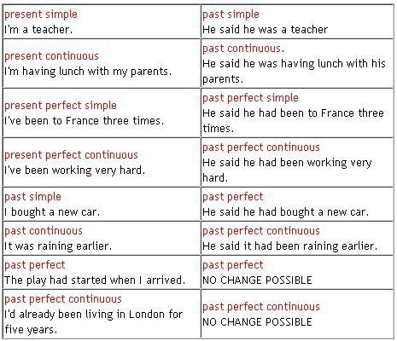

Slide 7
Reported Questions ( Wh-questions)
How about questions?
Direct speech: Where do you live?
How can we make the reported speech here? In fact, it's not so different from reported statements. The tense changes are the same, and we keep the question word. The very important thing though is that, once we tell the question to someone else, it isn't a question any more. So we need to change the grammar to a normal positive sentence.

Slide 8
Maybe this example will help :
Direct speech: Where do you live?
Reported speech: She asked me where I lived.
The direct question is in the present simple tense. We make a present simple question with 'do' or 'does' so we need to take that away. Then we need to change the verb to the past simple. Another example :
Direct speech: Where is Tom?
Reported speech: She asked me where Tom was.

Slide 9
Reported Questions ( yes/no questions)
We don't have any question words to help us, instead, we use 'if':
Direct speech: Do you like chocolate?
Reported speech: She asked me if I liked chocolate.
Direct Question | Reported Question
Do you like me? | He asked me if I liked him.
Have you ever been to London? | She asked me if I had ever been to London.
Are you living here? | She asked me if I was living here.

Slide 10
Reported Requests
What if someone asks you to do something (in a polite way)? For example:
Direct speech: Close the window, please
We simply use 'ask me + to + infinitive':
Reported speech: She asked me to close the window.
To report a negative request, use 'not':
Direct speech: Please don't be late.
Reported speech: She asked us not to be late.

Slide 11
Reported Orders
We can call this an 'order' in English, when someone tells you very directly to do something.
For example:
Direct speech: Sit down!
In fact, we make this into reported speech in the same way as a request. We just use 'tell' instead of 'ask':
Reported speech: She told me to sit down.
Negative:
Direct speech: Don’t talk!
Reported speech: He told me not to talk.

Slide 12
Изработил:
Габриела Мамакис- Петковска
Наставник по Англиски јазик
ОУ Стив Наумов - Битола

