Slide 1
Good __________!

Slide 2
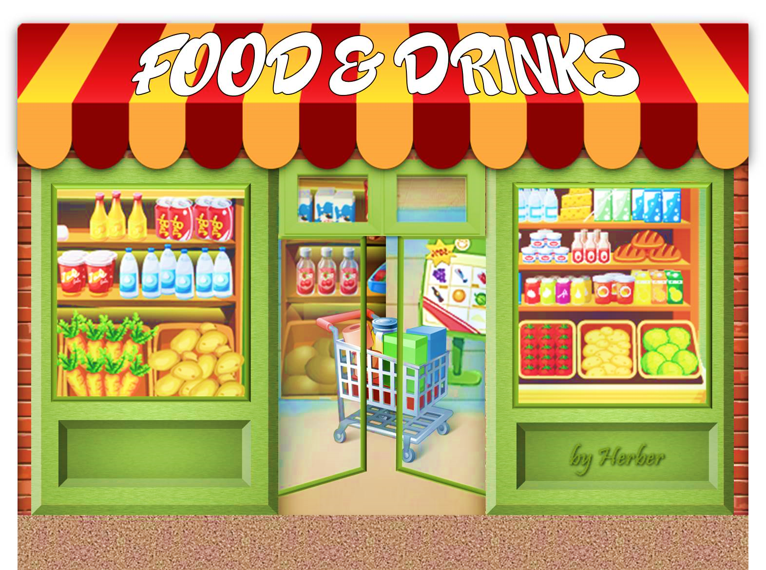
fruit

Slide 3
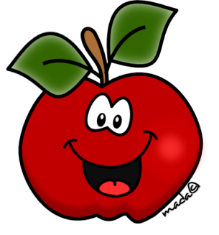
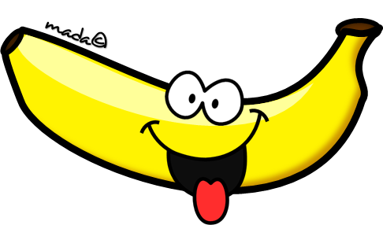
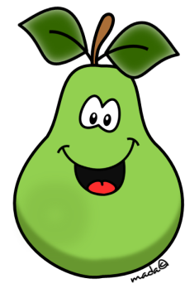
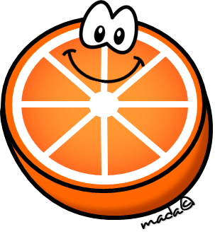
fruit
apple
banana
mango
orange
pear
peach

Slide 4
Let’s sing a song. ‘fruit song’ by happy sunshine https://www.youtube.com/watch?v=Up-roZEGqgA

Slide 5
FRUIT
Billy Goat likes fruit.
He is very hungry.
Can you feed him?
If your answer is correct, Billy Goat can eat the fruit!
PLAY

Slide 6
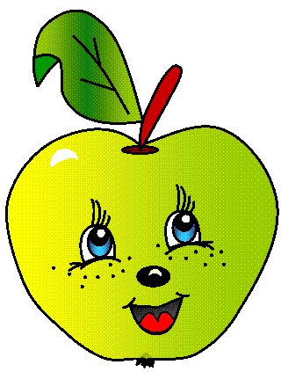
FRUIT
What is it?
1mango
2apple
3banana
4pear

Slide 7
FRUIT
What is it?
1pear
2apple
3mango
4banana

Slide 8
FRUIT
What is it?
mother
orange
peach
banana

Slide 9
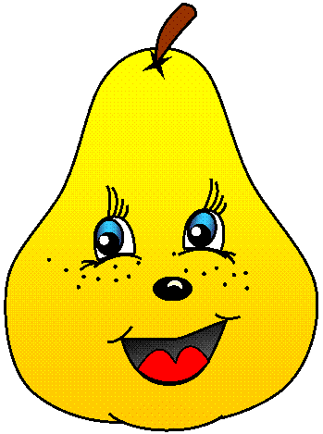
FRUIT
What is it?
1pear
2peach
3orange
4banana

Slide 10
FRUIT
What is it?
1father
2peach
3banana
4mango

Slide 11
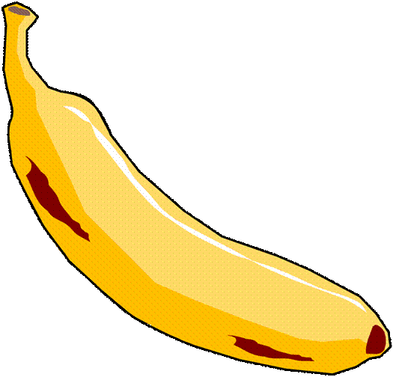
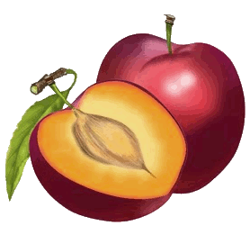
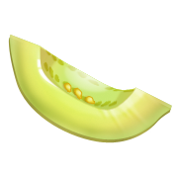
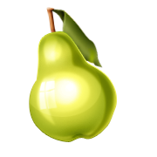
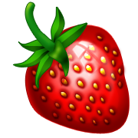
Spin the wheel and click the right word

Slide 12
Spin the wheel and click the right word
apple
pear
melon
strawberry
watermelon
lemon
pineapple
banana
orange
blackberry
plum
peach

Slide 13
Spin the wheel and click the right word
apple
pear
melon
strawberry
watermelon
lemon
pineapple
banana
orange
blackberry
plum
peach

Slide 14
Spin the wheel and click the right word
apple
pear
melon
strawberry
watermelon
lemon
pineapple
banana
orange
blackberry
plum
peach

Slide 15
Spin the wheel and click the right word
apple
pear
melon
strawberry
watermelon
lemon
pineapple
banana
orange
blackberry
plum
peach

Slide 16
Spin the wheel and click the right word
apple
pear
melon
strawberry
watermelon
lemon
pineapple
banana
orange
blackberry
plum
peach

Slide 17
Let’s sing a song. ‘fruit song’ by english tree https://www.youtube.com/watch?v=Jobe-NmlRAc

Slide 18
A or An?
A peach
An orange
A pear
An apple
A
An
BCDFGHJKLMNPQRSTVWXYZ
A E I O U

Slide 19
A peach
An peach
NEXT

Slide 20
A orange
An orange
NEXT

Slide 21
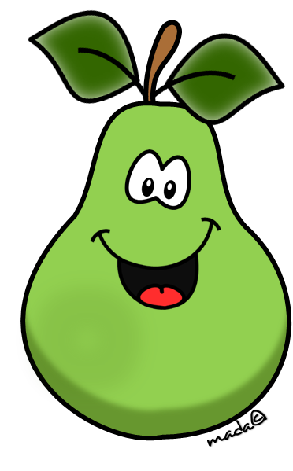
A pear
An pear
NEXT

Slide 22
A apple
An apple
NEXT

Slide 23
1 one apple
2 apple
s

Slide 24
peach
peache
s

Slide 25
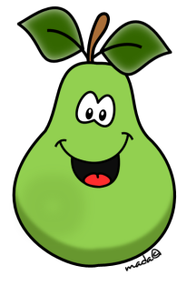
Pears
A pear
NEXT

Slide 26
A peach
Peaches
NEXT

Slide 27
An orange
Oranges
NEXT

Slide 28
Apples
An apple
NEXT

Slide 29
Let’s sing a song. How much is the doggie in the window https://www.youtube.com/watch?v=9oihSmbfDgI

Slide 30
What do you like?
I like apples

Slide 31
What do you like?
I like.... pears apples oranges
peaches
bananas

Slide 32
What does your friend like?
He/She likes.... pears apples oranges
peaches
bananas

Slide 33
Гоце Делчев Битола
Homework:
Write 5 positive and 5 negative sentences about your friend’s likes and dislikes
e.g. She likes apples. She doesn’t like pears.
Write 10 questions and give five short positive and five short negative answers
e.g. Does Ana like pears?
Yes, she does.
Does John like apples?
No, he doesn’t.
Ова ви е обврска за оваа недела
STAY HOME- BE SAFE
Виолета Најдовска

