Slide 1
UNIT 8
Time to spare
Teacher: Darko Ackovski Class: I-3

Slide 2
Unit plan
Reading: article, missing sentences
Vocabulary: words related to free time, word formation, phrasal verbs
Grammar: modals & semi-modals, modals perfect
Listening: multiple-choice questions
Speaking: talking about free-time activities, problem solving, giving advice
Writing: article, making articles interesting

Slide 3
Reading & Vocabulary:
(pages 97-98)
Please pay attention to the meaning of any unfamiliar words you (we’ve done this in our previous lessons);
Re-read the texts about the caves (p 96-97) and Brothers Grimm (p 98);
Exercise E (p 97): Complete the definitions by inserting the words in their proper place;
Exercise B (p 98): Complete the sentences by distinguishing the two expressions (e.g. take time vs. spend time);
Exercise C (p 98): Complete the text with the words given;
Exercise D (p 98): Think of some leisure activities that you enjoy in your free time (since you have plenty of it these days)

Slide 4
Grammar:
Modals & Semi-modals
(page 99)
Modal verbs for:
Ability (I am able to play football with both feet.);
Advice and suggestions (You should exercise indoors in wintertime.);
Lack of obligation or necessity (We needn't worry about the match tomorrow.);
Necessity, obligation and prohibition (Students mustn’t cheat during the examination process.);
Permission and request (Could you open the window, please?);
Possibility and certainty (He might move to Amsterdam next year.)

Slide 5
Listening:
(page 100)
Look at the pictures in exercise A and describe the connection between each set of three pictures;
Think about the possible topic and think of some possible questions (e.g. What are the best methods of transport in our country?);
Similar to Exercise A, come up with some brief comparisons or similarities in Exercise D (e.g. When is the best time to start a concert and why?)

Slide 6
Speaking:
(page 101)
What do you do in the summer holidays?
Do you like to relax in your free time during summertime or do you prefer to earn some amount of money while working part-time?
What advantages and disadvantages has your decision got?
Please pay attention to some useful expressions while giving advice to somebody you know (e.g. If I were you, I would…)
If you had the possibility to go to a Work & Travel Program in the US, would you give it a try? What would your seasonal job be and where would you like to work?

Slide 7
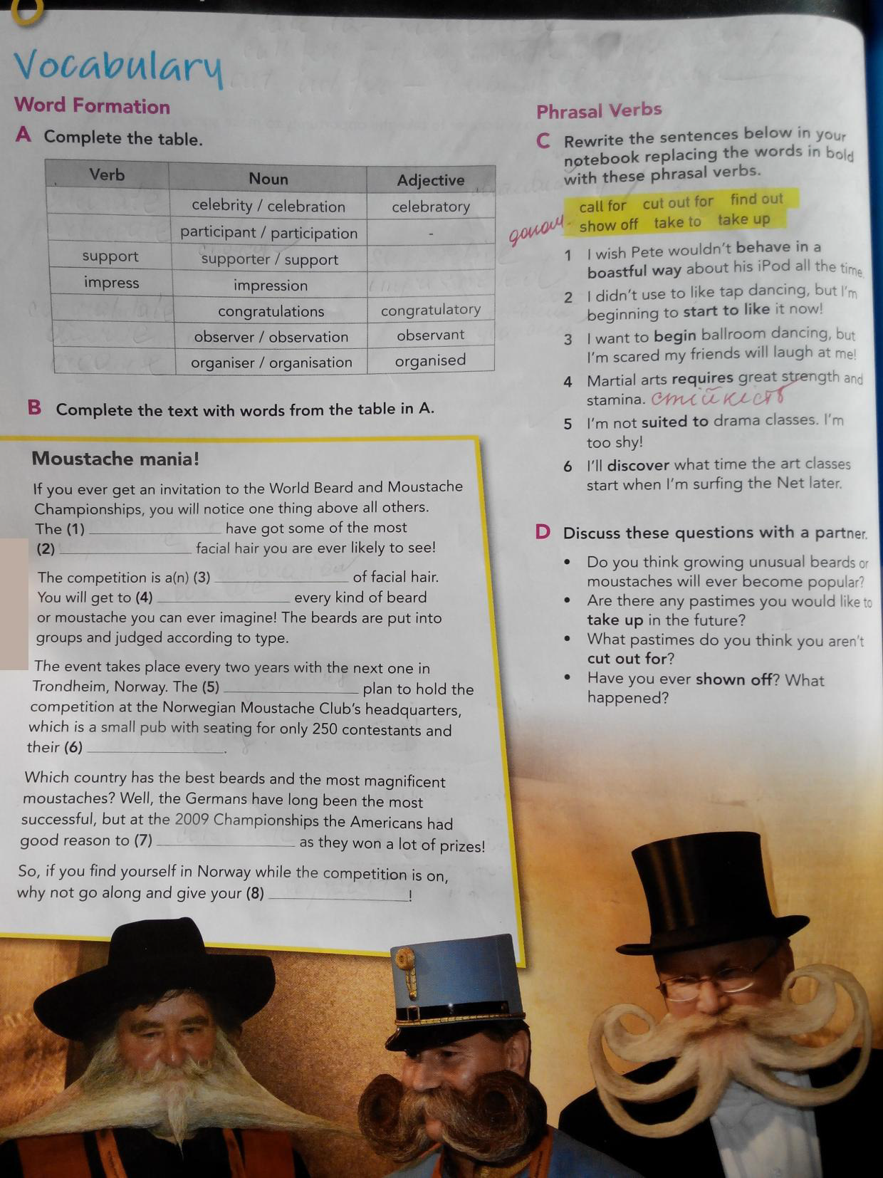
Vocabulary:
(page 102)
Exercise A: Please pay attention to the table and its word formation (Verbs, Nouns or Adjectives) and fill in the correct forms in the blank spaces;
Use these words to fill in the blank spaces in the text below (Exercise B);
Phrasal verbs:
Call for = require
Cut out for = suited to
Find out = discover
Show off = behave in a boastful way
Take to = start to like
Take up = begin

Slide 8
Modals – Perfect Tense
Whenever we use modal verbs in Perfect tense, we use the modal verbs (Should; Could; Would, Must; May; Might, etc.) + have + past participle.
In this case, we never change have into has in third person singular:
(e.g. He should have told you earlier. Now it’s too late to make any additional changes.)
Please put the correct function of the modal verbs in the given group of sentences by using the knowledge you got from page 99;
Solve Exercises B and C in the same manner, by using the correct modal verb.

Slide 9
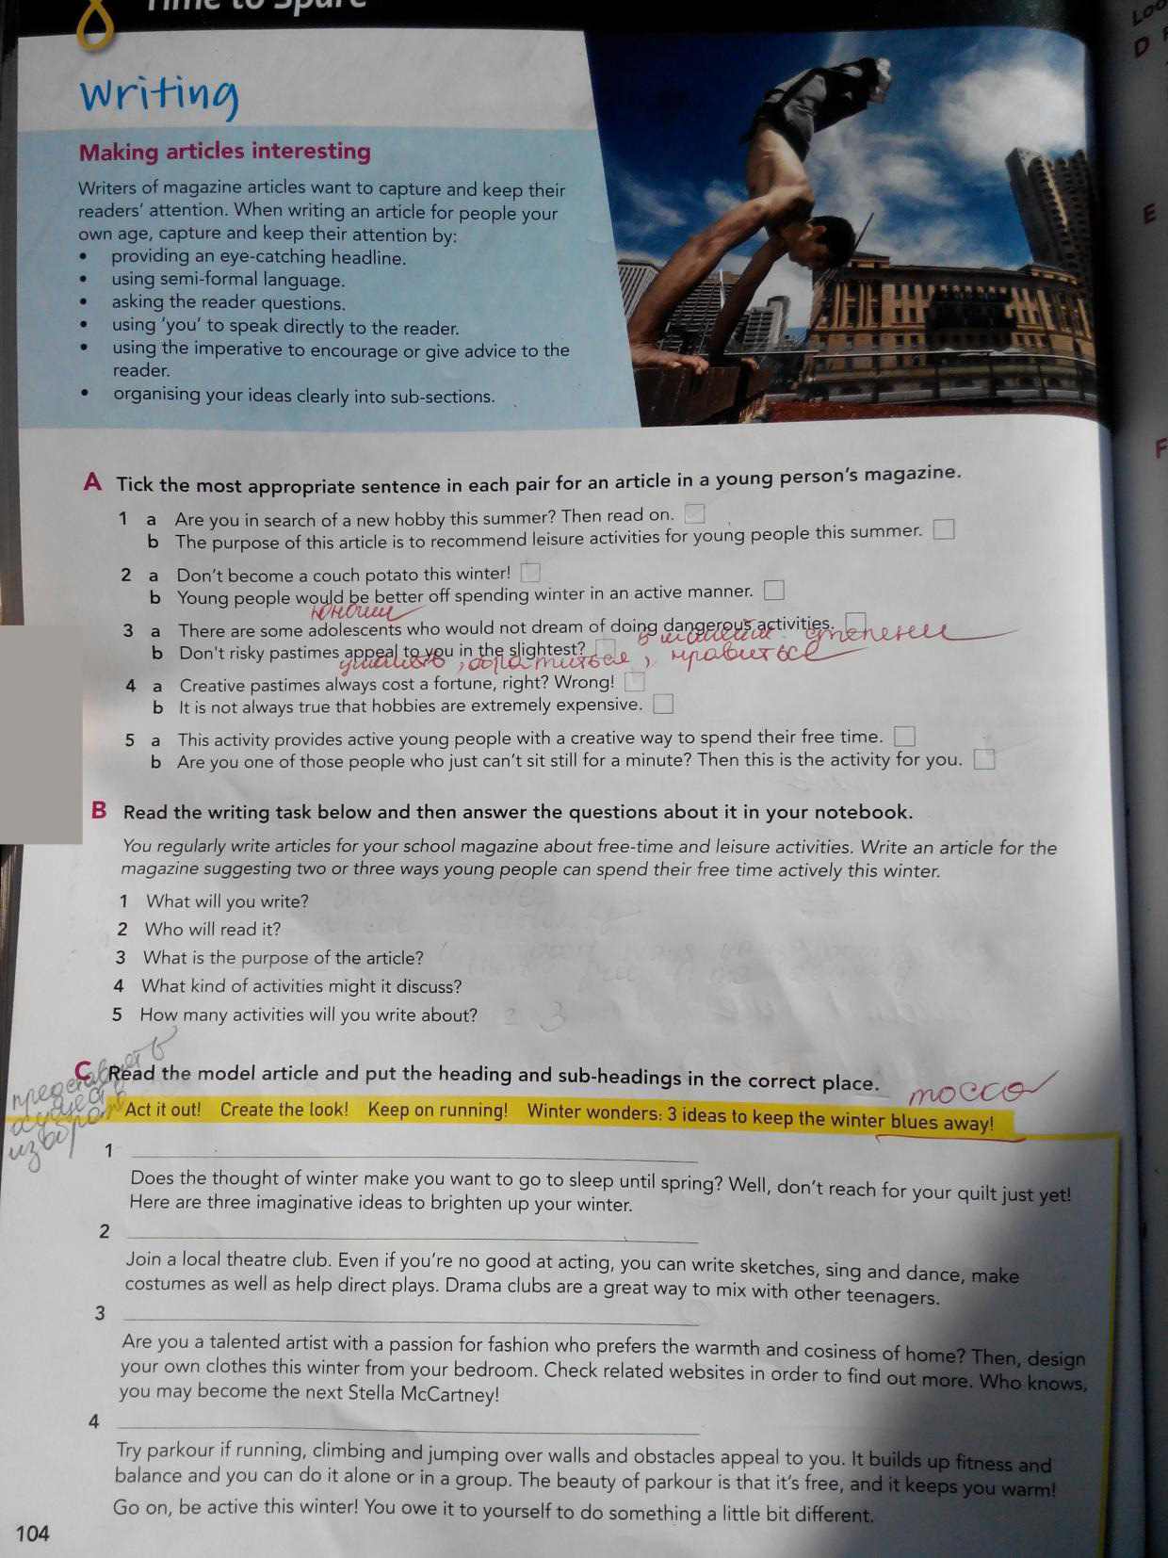
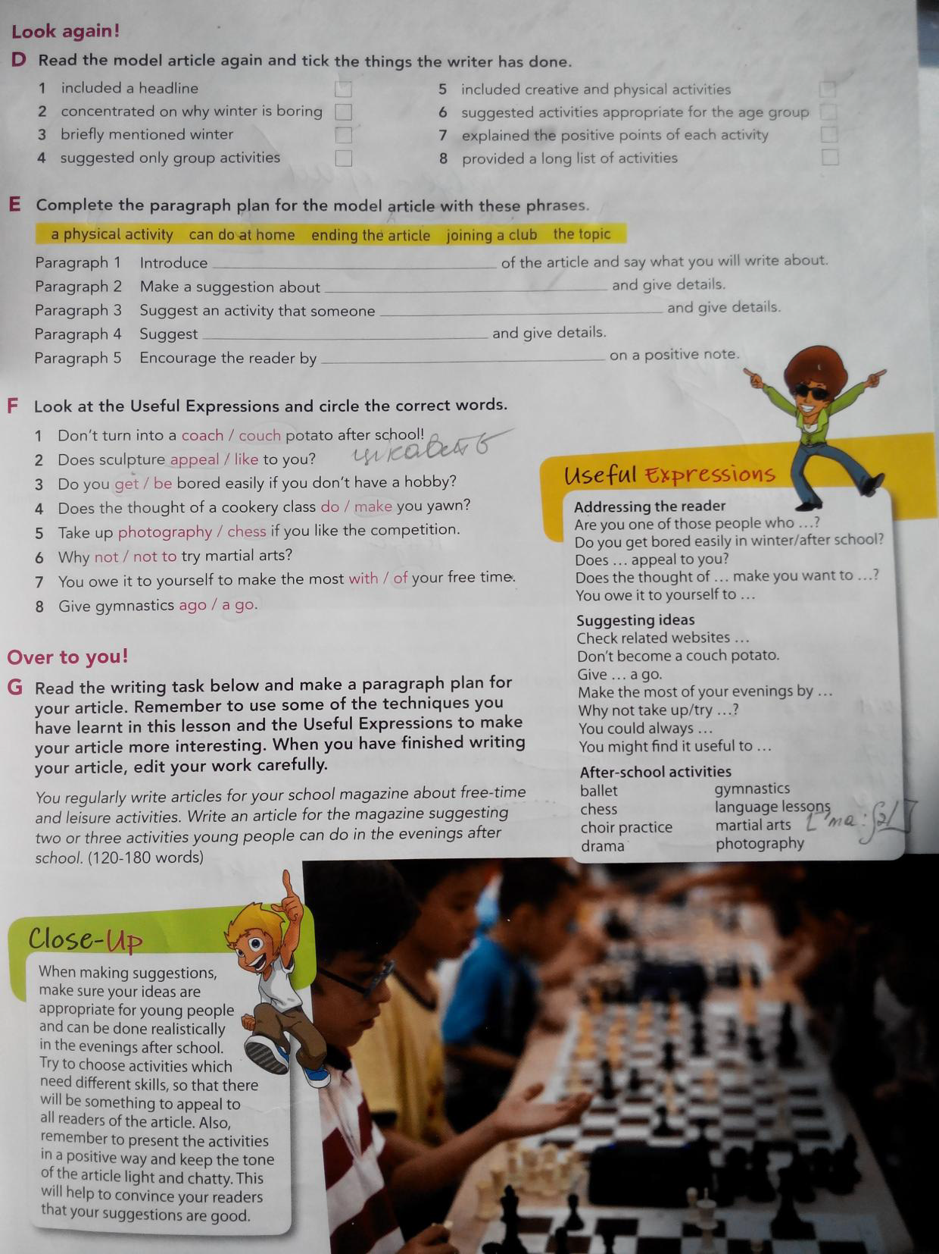
Writing:
(pages 104-105)
Choose the most suitable sentence in each pair of sentences (Exercise A);
Think about the five segments all articles should contain (What is the topic about; Who is intended for; What purpose has it got; What activities are included in it; how many activities are there) (Exercise B);
Read the model article in Exercise C and use the heading and sub-headings to complete the article.
In Exercise G, please give it a try and write an article (~150 words) for your school magazine about free-time and leisure activities. Use the five segments mentioned in Exercise B, as well as the Useful Expressions on page 105.

