Slide 1
Primary school “Gjorgji Sugarev”- Bitola Simple Past vs. Present Perfect VIII grade (Messages 3 )
When do we use each tense in English?

Slide 2
Use the simple
Use the present perfect for
past for
action that happened in the past and is:
over, done, finished!
action that started in the past, but . . .
is still true today.

Slide 3
The simple past always refers to an action or situation that is finished.
The present perfect connects the past and the present. It is used to show that an action or situation in the past:
-continues today, OR
-might happen again

Slide 4
Compare the meaning of these two sentences:
Sara lived in Boston for 5 years.
Sara has lived in Boston for 5 years.
The first sentence uses: Simple Past
The second sentence uses: Present Perfect

Slide 5
Sara lived in Boston for 5 years.
Meaning: by using the simple past tense, we mean that Sara started living in Boston 5 years ago . . .
AND . . . then she moved!
Now she lives in a different city, like Paris.
Remember, the simple past is used for a situation that is over, finished, done!

Slide 6
Sara has lived in Boston for 5 years.
Meaning: by using the present perfect tense, we mean that Sara began living in Boston 5 years ago .
. .
AND . . . she still lives there. Remember, present perfect:
connects the past with the present.

Slide 7
Use the simple past with time
Use the present perfect with
words like:
yesterday
last Saturday, week,
time words like:
recently/lately
since …
so far this
week, month, year, etc.
month, year, etc.
•
ago
when I was…
in 1990 (past date)

Slide 8
Additional notes about present perfect:
We often use present perfect to say that something happened sooner than expected.
Example:
Jan: Don’t forget to mail that letter. Tom: I’ve already mailed it.

Slide 9
We often use present perfect to say that we have never done something at any time in the past.
Example:
I have never visited London. But someday, I hope to travel there.

Slide 10
We often use present perfect with the expression: “This is the first time.”
Example:
Leonard is nervous. This is the first time he has flown on an airplane!

Slide 11
We often use present perfect with “ever” and “never.”
Example:
Patricia: Have you ever played tennis?
Linda: No, I’ve never played before, but I would like to learn!

Slide 12
Remember!
If you are talking about a specific time in the past (yesterday, last month, etc.), you cannot use the present perfect.
In these cases, use the simple past.

Slide 13
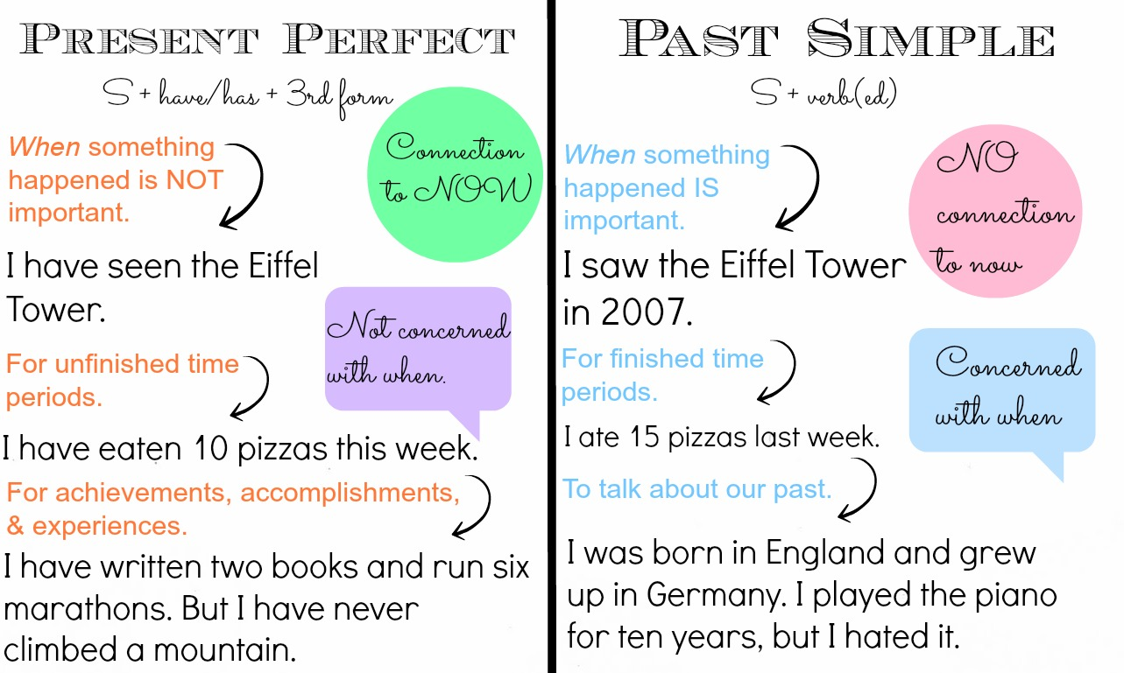
CONCLUSION

Slide 14
GRAMMAR PRACTICE You can check your knowledge after every finished exercise !!! Just follow the links !!! Enjoy your day !!
https://web2.uvcs.uvic.ca/courses/elc/studyzone/330/grammar/upperf2.htm
http://www.adelescorner.org/grammar/pres_perfect/pres_per_vs_past_simple.html
http://www.focus.olsztyn.pl/en-exercises-on-present-perfect-tense.html
https://web2.uvcs.uvic.ca/courses/elc/studyzone/330/grammar/upperf2.htm

Slide 15
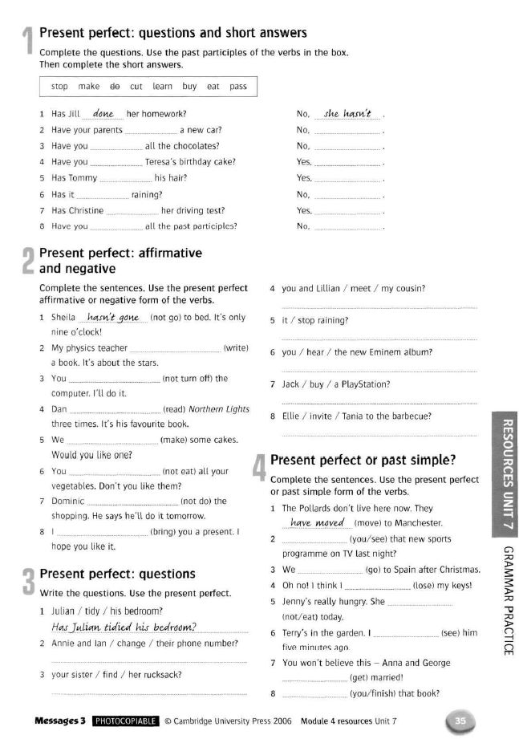
Homework
Read the instructions cars
Feel free to contact your teacher and ask questions !!!
Kind regards my students!
Stay at home ! Be safe !!!
Your teacher of English
Daniela Lavurovska

