Slide 1
Present Continuous Tense
КАКО СЕ ПРАВИ
Present Continuous Tense

Slide 2
PRESENT CONTINUOUS
To form the present continuous, we use the am / is / are form of the verb "to be" plus the infinitive of the verb plus an -ing ending. The form is the same for each subject.
За да го формираме ова време после личното име, лична заменка и сл го употребуваме глаголот "to be" (am / is / are ), потоа главен глагол на кој му ја додаваме наставка -ing .

Slide 3
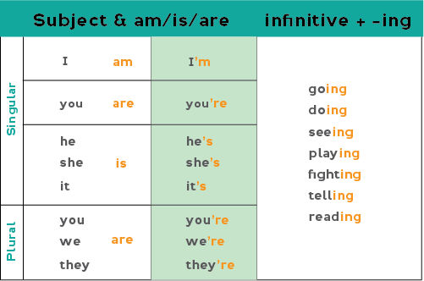
Affirmative form

Slide 4
Examples:
I am going to school. / I'm going to school.
You are doing the dishes. You're doing the dishes.
He's seeing his doctor now.
She's playing with her dog outside.
We are fighting over which tv show to watch.
You are all telling me different stories.
They are reading quietly before bedtime.

Slide 5
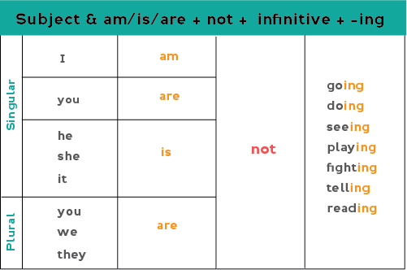
Negative form To make the tense negative add "not" before the verb + -ing.

Slide 6
Examples:
I am not going to bed now.
You are not doing your homework now.
The children are not sleeping at this time.
My boyfriend is not telling me everything.
They are not reading today's newspaper.
Исто така за употреба на негативната форма ги користиме и кратките форми isn’t /aren’t.
She isn’t at home now.

Slide 7
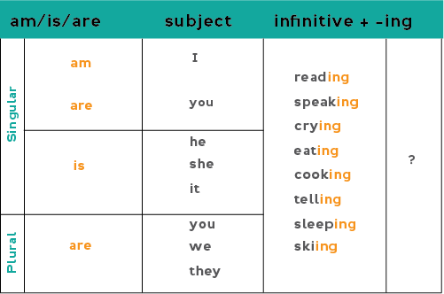
Interrogative form

Slide 8
Examples:
Am I reading a book right now?
Is he speaking on the phone with your teacher?
Is the baby still crying?
Is the dog eating his food now?
Are we cooking together at this moment?
Are they sleeping yet?

Slide 9
Spelling: Verbs that end with one –e
Глаголи кои завршуваат на едно е, тоа е го испуштаат и се додава наставка+ ing.
examples
bake — baking
love — loving
take — taking
make — making
have — having

Slide 10
Spelling: Short one-syllable verbs ending in CVC
Глаголи кои завршуваат на согласка,самогласка, согласка, ја дуплираат последната согласка и потоа се додава + ing.
examples
sit — sitting
get — getting
run — running
put — putting
stop — stopping
swim — swimming

Slide 11
Spelling: Verbs ending in –ie
Глаголи кои завршуваат на –ie тоа преминува во у, па потоа додаваме –ing
examples
die — dying
lie — lying
tie — tying

Slide 12
USE
Ете и кратко видео за употребата на времето.
https://youtu.be/We_m8tyMqcE?fbclid=IwAR22q0hZ3T3fsA70by40It7fhi9gvI_SgNe9KX7vMx46asICqkX3VmHqBw0

Slide 13
EXERCISES ВЕЖБИ
1. Complete the sentences in present continuous with the verbs given.
Доврши ги речениците со дадените глаголи во Present Continuous
а. The birds . ARE SINGING (sing).
b. My sister ............... (watch) TV and I ............... (read) a great novel.
c. We ............... (have) a very good time on holidays.
d. She ............... (work) at the moment but she finishes at 6.
e. ...... it ...... (rain) now? Yes, it is.
f. James ............... (play) football in the park now.
g. Harry and Anne ............... (go) to the cinema.
h. They ............... (clean) the whole house.

Slide 14
EXERCISES ВЕЖБИ
2. Write these sentences in the negative (short form)
Напиши ги речениците во негативна кратка форма
1. Mrs Thompson is watching her favourite series on TV.
Mrs Thompson isn’t watching her favourite series on TV.
2. That boy is eating an ice-cream. ...........................................................................................
3. I´m going to the mountain.
...........................................................................................
4. They are making dinner.
...........................................................................................

Slide 15
EXERCISES ВЕЖБИ
3. Ask questions as in the example.
Поставувај прашања како во дадениот пример
1. Man / run Is the man running?
2. Mum / eat / cake ............................................................................
3. That man / read / the paper ............................................................................
4. They / wear / T-shirts ............................................................................
5. The birds / fly ...........................................................................
6. You / listen / to me ...........................................................................

Slide 16
Подготвил:
Наставник
Александра Симончевска Нечовска
ОУ.Св.Кирил и Методиј- Битола

