Slide 1
Defining and non-defining relative clauses

Slide 2
Relative pronouns
We use relative clauses to give extra information. We use:
__________ to refer to people.
__________ to refer to things.
__________ for possessions.
__________ to refer to places.
who / that
that / which
whose
where

Slide 3
Defining relative clauses
who
The woman is signing books is my favourite author.
I usually choose books by authors characters are really inspirational.
The cinema I saw the film was old.
I don’t like books have got a lot of violence.
whose
where
that

Slide 4
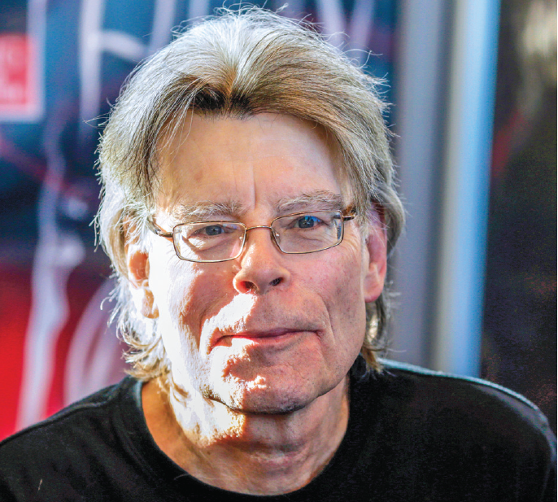
Non-defining relative clauses
,who is American,
Stephen King
is a famous writer.
,
which was written for children
,
Harry Potter
is enjoyed by adults too.
,where the film is set,
Barcelona
is beautiful.
whose autobiography is called Long Walk to Freedom
Nelson Mandela
,
died in 2013.
,

Slide 5
Relative clauses in action
whose
Roald Dahl, parents were Norwegian, was brought up in Wales. He wasn’t happy at school, he was brilliant at sport but not very good as a writer.
His first children’s novel, was called The Gremlins, was published in 1943 and he went on to write many well known stories . are still popular today. Matilda, Fantastic Mr Fox and The Witches are a few examples of books have all been made into films. His stories, usually include villains and a good adult, are thought to reflect his childhood experiences.
where
which
that
which
which

Slide 6
GET IT RIGHT!
I’m going to visit my Uncle Joe, which lives in London.
I’m in Brazil, that is a beautiful country.
The girl, who dad was Spanish, had blonde hair.
The town which the story is set is fictional.
I’m going to visit my Uncle Joe, who lives in London.
I’m in Brazil, which is a beautiful country.
The girl, whose dad was Spanish, had blonde hair.
The town where the story is set is fictional.

Slide 7
Can you remember the rules?
Defining relative clauses (DRC – tell us exactly which person or thing is being referred to and without the DRC the sentence is incomplete)
A defining relative clause identifies an object, a person, a place or a possession.
We need this information to know who or what is being talked about.
When we write these sentences, we don’t use any commas.
The woman was a genius. She wrote this book.
⇨
I saw a film last night. The film was terrible.
⇨
The woman who wrote this book was a genius.
The film that I saw last night was terrible.

Slide 8
Non-defining relative clauses (ND – add secondary information to a sentence and without the ND clause, the sentence is complete)
We use non-defining relative clauses to add extra information which is not needed to understand the sentence.
We put commas round these clauses when we write them.
They are rarely used in conversational language.
We don’t use that in non-defining relative clauses.
My uncle lives in Sydney. He’s a very successful writer.
⇨
My uncle, who lives in Sydney, is a very successful writer.

Slide 9
Describe a person, place or object. Can you partner guess what it is?
Stephen King
a camera
Australia
Scotland
a radio
Kristen Stewart
the microwave
the internet
a calculator
Ireland
Robert Pattinson
GPS
a fridge
New Zealand
Charles Dickens

Slide 10
QUIZ!
who
1 Charles Dickens, ____ lived in London all his life, had a secret door which looked like a bookcase in his house.
2 The first book ______ was bought on Amazon was called Fluid Concepts and Creative Analogies: Computer Models of the Fundamental Mechanisms of Thought.
3 In the UK, ______ children are taught to read from the age of seven, a fifth of the £2.2 million yearly book sales are spent on children’s books.
4 The Japanese work ‘tsundoku’ means buying a load of books _____ you don’t get round to reading.
5 Bibliosmia is the word _____ is used to describe the enjoyment of the smell of old books.
6 In 2007, Stephen King, ______ books include It and Misery, was mistaken for a vandal at a book signing in an American book store.
 He was born in Portsmouth and lived in Kent.
which
TRUE
where
 Children are taught to read from the
age of four.
that
TRUE
that
TRUE
whose
 He was in Australia when this happened. It was a surprise visit and they thought he was vandalising the books!

Slide 11
Acknowledgements
The authors and publishers acknowledge the following sources of copyright material and are grateful for the permissions granted. While every effort has been made, it has not always been possible to identify the sources of all the material used, or to trace all copyright holders. If any omissions are brought to our notice, we will be happy to include the appropriate acknowledgements on reprinting and in the next update to the digital edition, as applicable.
The publishers are grateful to the following for permission to reproduce copyright photographs and material:
Slide 3: ©KIM NGUYEN/Shutterstock; Slide 4: ©KENZO TRIBOUILLARD/AFP/Getty Images.
Written by Emma Szlachta.

