Slide 1
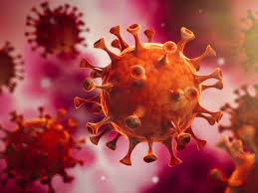
READING
VOCABULARY
COMPREHENSION
WRITING
ОСМУ ,,Д-р Јован Калаузи” – Битола
Лилјана Билјановска – англиски јазик
THE CORONAVIRUS - COVID-19
https://www.who.int/

Slide 2
Lesson overview
In this lesson, you will learn 6 facts about COVID-19, the coronavirus outbreak of 2019-2020.
Learning objectives
Find out what the virus is. Learn and use new, related vocabulary. Express your thoughts and ideas on the topic. Learn the basic preventive measures.
.
Keywords
Virus, prevention, contagious, quarantine, outbreak…

Slide 3
Find out more!
https://www.youtube.com/watch?v=JKpVMivbTfg
6 FACTS ABOUT THE CORONAVIRUS COVID-19
COVID-19 started in animals.
This particular coronavirus jumped from animals to humans in late 2019. The outbreak began at a seafood market in the Chinese city of Wuhan. A Chinese doctor who warned the medical community about the virus died from it on February 7, 2020.
2. COVID-19 is contagious.
According to many health experts, the average person who contracts COVID-19 will pass it on to about two other people. To limit the spread, those who have this contagious illness or who have been near someone who has it should go into quarantine.
3. COVID-19 symptoms are similar to the flu.
It’s difficult to distinguish flu symptoms from coronavirus symptoms. Typical symptoms of this coronavirus are fever, a dry cough, and shortness of breath. Most COVID-19 patients do not have a runny nose or sore throat.
4. The mortality rate of COVID-19 is unknown.
At this stage, health experts can only estimate the mortality rate of this coronavirus. Estimates range between 1% and 4%. Many countries lack the testing kits to diagnose this virus even though more kits are constantly being produced. We do know that elderly people are at a higher risk of death than young people.
5. There is no vaccine for COVID-19.
Health experts are working on a vaccine for this coronavirus. However, they estimate it will take at least 18 months before it is available. Fortunately, many people with the coronavirus recover, some even without any treatment.
6. Prevention is key to limiting the COVID-19 outbreak.
Social distancing help to prevent community spread; health experts recommend washing hands with soap and water for at least 20 seconds (or using hand sanitizer). It’s also important to cover one’s mouth with a sleeve or tissue when coughing or sneezing. People with flu symptoms should stay at home.
Extend your knowledge
You can extend the knowledge by watching a video about bacteria and viruses
on YouTube: https://youtu.be/s-HThHRV4uo

Slide 4
Comprehension
Read the statements below. If the statement is true based on the reading on Slide 3, write T beside the sentence. If it is false, write F and correct the information in your notebook.
_______ 1. The coronavirus COVID-19 started in a grocery store.
_______ 2. The doctor who first spoke about the new coronavirus also had the disease.
_______ 3. It’s easy to tell if you have the flu vs. COVID-19.
_______ 4. A vaccine for COVID-19 was available shortly after the outbreak.
_______ 5. The best way to avoid COVID-19 is to hang out with your friends in a café, but outside.
.
.
What is the difference between epidemic and pandemic? Write down your answer in your notebook!

Slide 5
Vocabulary preview
Match up the words with their meanings. Refer to context on Slide 3 if necessary. Be sure to write the new vocabulary in your notebook.
_______ 1. outbreak a) to get better
_______ 2. virus b) to recognize the differences
_______ 3. quarantine c) to identify an illness
_______ 4. contagious d) an infectious agent that causes disease in living things
_______ 5. distinguish e) the number of deaths (e.g., per illness or population)
_______ 6. mortality rate f) a period or state of isolation to prevent the spread of infection
_______ 7. diagnose g) able to be spread from one person to another
_______ 8. vaccine h) a liquid alternative to soap and water that kills germs
_______ 9. recover i) a sudden increase in something negative (e.g., disease or war)
_______ 10. hand sanitizer j) a substance that provides immunity against a disease
.
What is the difference between virus and bacteria? Do the research and write down your answer in your notebook.
.

Slide 6
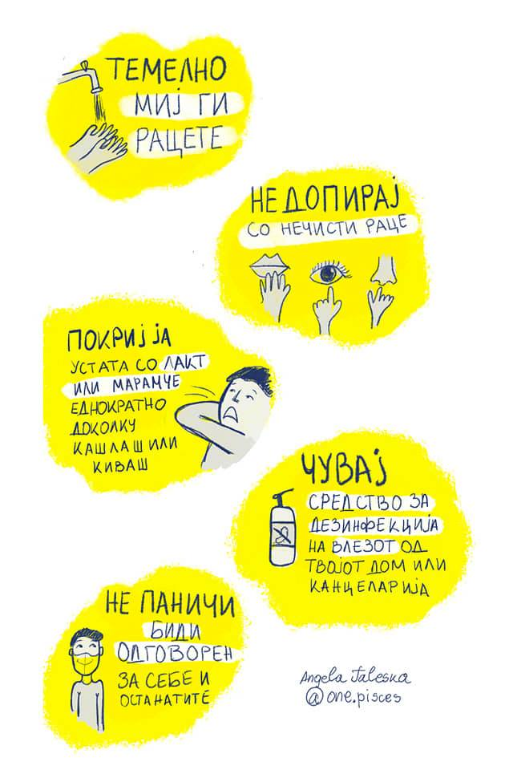
What did he say?
Below are some of the recommendations supported by the Minister of Health, Filipche, V.
Translate at least five of them in your notebook. Do you follow these instructions? Which one do you think is most effective and why?
https://www.youtube.com/watch?v=8c_UJwLq8PI
http://zdravstvo.gov.mk/

Slide 7
Writing
Choose one of the following questions and answer it in 8-10 sentences in your notebook.
1. In your opinion, is the coronavirus currently “public enemy number one”? Why, or why not?
2. Have you purchased any emergency or preventive supplies due to this outbreak? Tell me.
3. Do you think the world is overreacting about this virus? Explain.
4. If you were offered a free, three-week vacation on a cruise ship, all expenses paid for, would you go now?
5. Have you been following the Minister of health’s instructions to stay at home and prevent community spreading? Why, or why not?
6. How has the pandemic affected your life? Explain.
.
.

Slide 8
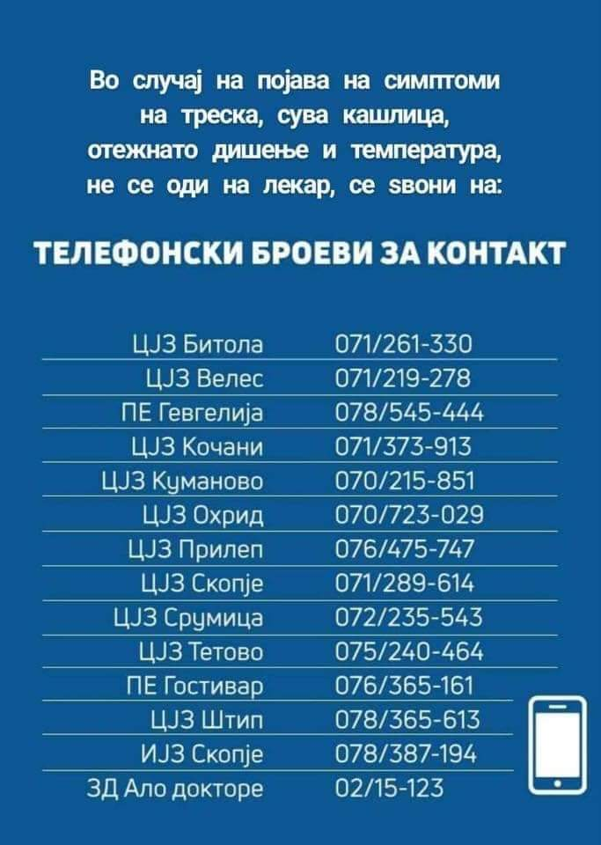
#СЕДИДОМА
https://www.who.int/news-room/q-a-detail/q-a-coronaviruses
https://www.who.int/emergencies/diseases/novel-coronavirus-2019

