Slide 1
make / let and be allowed to

Slide 2
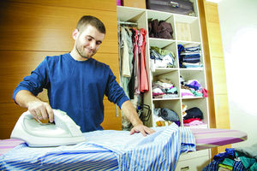
make
My parents make me do the ironing.
Mum makes me wash up after dinner.
Does your teacher make you do homework every night?
My dad made me put the rubbish out yesterday.

Slide 3

let
My family lets me go skydiving.
Does your brother let you borrow his laptop?
My parents let me eat lots of sweets.
Our teacher let us go home early yesterday.

Slide 4
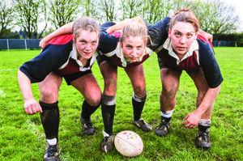
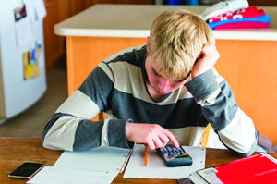
be allowed to
I’m not allowed to go out until I’ve finished my homework.
We’re allowed to play rugby at our school.
Are you allowed to use social media sites?
We were allowed to cycle into town yesterday.
I was allowed to ride my new mountain bike.

Slide 5
make / let and be allowed to in action
Ben What will you let your children do that you are not allowed to do now?
Dan I’m not sure. My mum lets me have some freedom. She makes me come home early in the week but not at the weekend for example.
Ben Well, would you let him or her go to a weekend music festival?
Dan Hmm. You’re not allowed to go to the Q Festival, are you?
Ben No! But if you ask your mum, she might let me go!
1 Does Dan have to come home early at the weekend?
2 Can Ben go to the music festival?
3 What’s Ben’s solution?
No
No
If Dan can go, then he can go too.

Slide 6

GET IT RIGHT!
You were on TV and you didn’t make us know.
Our hosts let us to feel very comfortable.
You are not allow to make a noise in the library.
My dad makes me to help him in the garden.
You were on TV and you didn’t let us know.
Our hosts made us feel very comfortable.
You are not allowed to make a noise in the library.
My dad makes me help him in the garden.

Slide 7
Can you remember the rules?
make
We use make (someone) to talk about forcing someone to do something that perhaps they don’t want to do.
Our school makes us wear a uniform.
My sister made me clean her bike.
let
We use let (someone) to talk about permission to do the things we want to do.
Our parents let us sleep late on Sundays.
I let my brother use my laptop.
(= We cannot choose, it’s an obligation.)
(= I could not choose, my sister forced me.)
(= Our parents give us permission to sleep late.)
(= I gave my brother permission to use my laptop.)

Slide 8
Can you remember the rules?
(not) allowed to
We use (not) be allowed to do (something) to say that someone has (or has not) got permission.
I'm allowed to stay up late at the weekend.
When my parents were children, they weren’t allowed to go out at night.
We can also use subject + allow + object + to infinitive.
My parents allow me to stay up late at the weekend.

Slide 9
What country, what law?
Switzerland
Japan
Victoria, Australia
England
Mexico
Canada
Victoria, Australia
1 In __________________ , only a qualified electrician is allowed to change a light bulb.
2 In _________________, a person is not allowed to die in the Houses of Parliament. It was voted the most ridiculous law in 2007.
3 Flushing the toilet after 10pm isn’t allowed in _____________ .
4 The government lets people drive a car at 15 in _______________ .
5 You are not allowed to be fat in ______________ . In 2009, lawmakers set a maximum waistline, meaning every men over 40 years old must have a waistline measuring less than 31 inched, and woman less than 35 inches.
6 In __________________ , The government makes radio stations play one song in every five by a local artist.
England
Switzerland
Mexico
Japan
Canada

Slide 10
Discuss the questions.
let
1 Would you ____ your friend borrow your smartphone?
2 If you knew your friend had cheated in a test, would you ______ him/her tell the truth?
3 Would you ___ an old man/woman sit in your seat on a bus?
4 Would you be __________ travel abroad on your own?
5 Have you ever ______ someone cry?
6 Are you __________ have a TV in your bedroom?
make
let
allowed to
made
allowed to

Slide 11
Acknowledgements
The authors and publishers acknowledge the following sources of copyright material and are grateful for the permissions granted. While every effort has been made, it has not always been possible to identify the sources of all the material used, or to trace all copyright holders. If any omissions are brought to our notice, we will be happy to include the appropriate acknowledgements on reprinting and in the next update to the digital edition, as applicable.
The publishers are grateful to the following for permission to reproduce copyright photographs and material:
Slide 2: ©enis izgi/E+/Getty Images; Slide 3: ©Joe McBride/The Image Bank/Getty Images; Slide 4: (L) ©Darryl Leniuk/Digital Vision/Getty Images, (R) ©SimplyCreativePhotography/E+/Getty Images
Written by Emma Szlachta.

