Slide 1
Future continuous &
Future perfect

Slide 2
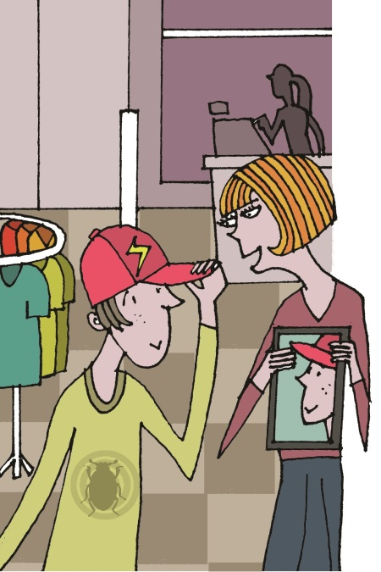
Future continuous
I for a new hat tomorrow afternoon.
will be shopping
will
+
be
+
the -ing form of the verb
My dad won’t be working in the finance department next year.
Will you be asking for a refund when you take the shoes back?

Slide 3
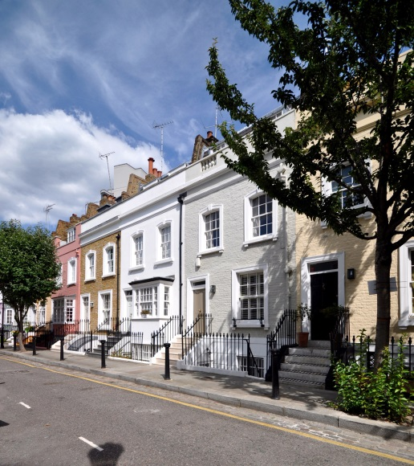
Future perfect
I house by this time next year.
’ll have moved
will
+
have
+
past participle
She won’t have finished work by 3 p.m. tomorrow.
Will you have started the homework before tomorrow?

Slide 4
Future perfect & future continuous
What’s the difference?
Will you be tidying your bedroom this weekend?
Will you have tidied your bedroom by this weekend?
We’ll be eating lunch between 1 p.m. and 2 p.m.
We won’t have finished eating by 2 p.m.
I’ll be finishing this homework tomorrow, so I can’t come.
I’ll have finished the homework by tomorrow, so I’ll come.
When I go to Italy this summer, we’ll be staying with my aunt.
By the end of the summer, I’ll have been in Italy for a month.

Slide 5

GET IT RIGHT!
By the end of next year, I will finish my studies.
This time next week, I’ll sit on the beach in Cádiz.
By Saturday, I’ll be spending all my money!
By the end of next year, I my studies.
will have finished
’ll be sitting
This time next week, I on the beach in Cádiz.
By Saturday, I all my money!
’ll have spent

Slide 6
Language in action
Alice: This time next week, I’ll be sitting on a beach in Mexico!
Lea: That sounds great. Will you have finished that History project before you go?
Alice: No, I won’t. I’ll be doing some research for it when I’m there.
Lea: What do you mean?
Alice: Well, Mr George agreed to let me do it on the Mayan culture. So while I’m in Mexico, I’ll be visiting Chichen Itza and going to a Mayan reservation.
Lea: Wow! So by the time you get back you’ll have collected all the information you need for the project.
Alice: That’s right!

Slide 7


Can you remember the rules?
Future continuous
We use the future continuous to talk about things that will be in progress at a specified time in the future. The future continuous is formed by will + be + the -ing form of the verb.
This time next week, I’ll be sitting on a beach in Italy.
Twenty years from now, we won’t be using money to buy things anymore.
Will you be working next week or have you got a holiday?
We don’t use the future continuous with stative verbs.
I’ll come but I
won’t be understanding
won’t understand
a thing.

Slide 8
Can you remember the rules?
Future perfect
We use the future perfect to talk about actions that will finish at some point between now and a specified time in the future.
We often use it with by + a point in time or by the time + a time clause.
Some people think that by 2050, credit cards will have disappeared.
By the end of the year, he’ll have earned more than £3 million.
now
the end of the year
£1 million
£2 million
£3 million

Slide 9
waiter/waitress | lawyer | police officer
teacher | doctor | rubbish collector
chef | pizza delivery driver | banker
10 pm Saturday night | me! | 2025
Wednesday afternoon | the summer | Sunday morning
Work in pairs.
Choose a time and a profession. Make a sentence.
By 10 pm on Saturday night, a waitress will have served 50 people.

Slide 10
Guess your friends’ future!
Write your classmate’s names. Write 2 of your own ideas.
1 ________ will be studying at university in a few years time.
2 ________ will have passed all his/her exams by the end of the year.
3 ________ will be spending the summer abroad.
4 ________ will have tidied his/her bedroom by Sunday.
5 ________ will have saved enough money to buy something in 6 month’s time.
6 ________ won’t be going on holiday with his/her parents this year.
7 ________ ________________
8 ________ ________________

Slide 11
Acknowledgements
The authors and publishers acknowledge the following sources of copyright material and are grateful for the permissions granted. While every effort has been made, it has not always been possible to identify the sources of all the material used, or to trace all copyright holders. If any omissions are brought to our notice, we will be happy to include the appropriate acknowledgements on reprinting and in the next update to the digital edition, as applicable.
The publishers are grateful to the following for permission to reproduce copyright photographs and material:
Slide 3: ©Ron Ellis/Shutterstock.
The publishers are grateful to the following illustrator:
Slide 2: Julian Mosedale.
Written by Emma Szlachta.

