Slide 1
(don’t) have to / ought to / should(n’t) / must / had better (not)

Slide 2
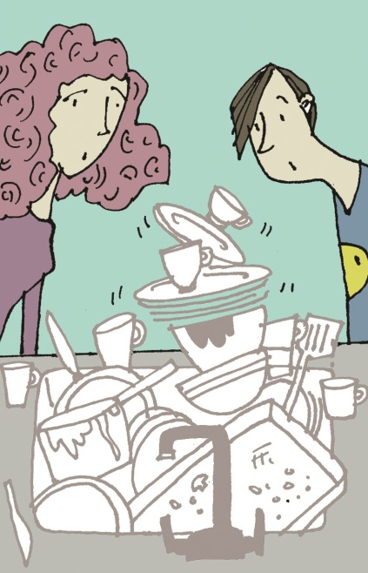
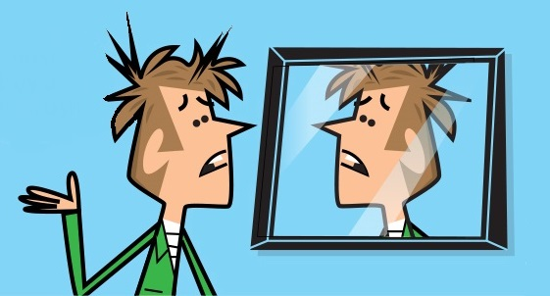
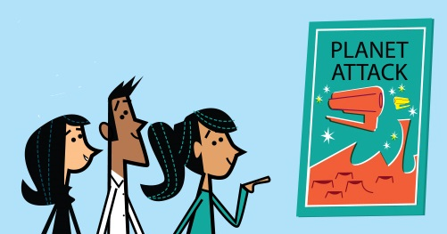
(don’t) have to / must
We have to do the dishes.
I must get a hair cut!
The film is free.
You don’t have to pay.

Slide 3
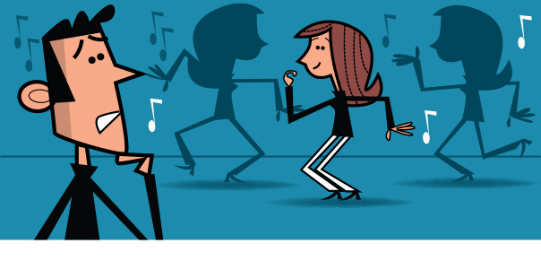
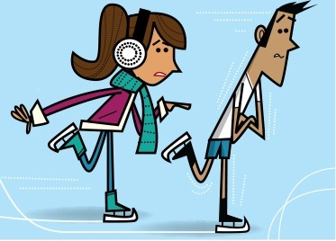
ought to / should (n’t)
He shouldn’t be so shy.
He ought to dance.
had better (not)
You’d better put your coat on – it’s cold.
You’d better not stay outside. You’ll get ill.

Slide 4




GET IT RIGHT!
If you want, you should bring some drinks.
If you want, you could bring some drinks.
I don’t have to work tonight, as I’ve already finished everything.
He ought to spend more time on his homework.
You had better not eat that bread.
If you want, you bring some drinks.
could
I mustn’t work tonight, as I’ve already finished everything.
I work tonight, as I’ve already finished everything.
don’t have to
He ought spend more time on his homework.
ought to
He spend more time on his homework.
You have better not eat that bread.
You eat that bread.
had better not

Slide 5
Language in action
Ana Have you done your homework yet?
Leo No, I haven’t. When do we .…………. hand it in?
Ana Tomorrow, so you ……….. to do it now or you won’t finish it in time.
Leo You’re right, I’d ……….. start now. What do you think I …………. do?
Ana I don’t know! It’s your homework.
Leo I ………. listen more in class, then I would know what to do.
Ana Yes and you ………… listen to me more often too!
have to
ought
better
should
must
should

Slide 6
Can you remember the rules?
(don’t) have to / must
have to
We use to say ‘this is important or necessary’.
We use to say that we, or other people, have an obligation to do something.
must
Our train leaves at 7 o’clock, so I have to get up early.
I must save some money for my mum’s birthday.
don’t have to
We use to say this is NOT important or necessary.
You don’t have to come with us if you don’t want to.

Slide 7
Can you remember the rules?
ought to / should
We use should or ought to to tell someone that something is a good idea.
Ought to isn’t as frequent as should. It is used mostly in writing and the negative form is rare.
We use shouldn’t to tell someone that something is not a good idea.
At the beach you should put some sun cream on.
That wasn’t a nice thing to say – you ought to say sorry.
You shouldn’t spend so much on clothes.

Slide 8
Can you remember the rules?
had better (not)
We use had better (not) to advise or warn people in strong terms. It is used to tell people about negative results in the future if they do / don’t do something.
The past form (had) is always used and it is often shortened to ’d.
You’d better hurry up (or you’ll miss the train).
He’d better not say that again (or I will be very angry).

Slide 9
Speaking
Choose one of the endings. Write a dialogue that ends with one of these sentences.
You ought to say sorry. She’s really upset.
You’d better tidy it up!
No! You mustn’t touch that button.
You should ask your mum before you do that.

Slide 10
Speaking
What advice can you give for the problems below? Talk in groups.
A boy at school is calling me names.
My cousin has named the day for her wedding, but I’m going to a music festival that weekend.
My mum bought me an expensive pair of jeans and I don’t like them.
I bought a cheap watch from a popular chain store and it’s broken.
My mum dropped her smart phone in the bath.
I lost £50 in town yesterday.

Slide 11
Acknowledgements
The authors and publishers acknowledge the following sources of copyright material and are grateful for the permissions granted. While every effort has been made, it has not always been possible to identify the sources of all the material used, or to trace all copyright holders. If any omissions are brought to our notice, we will be happy to include the appropriate acknowledgements on reprinting and in the next update to the digital edition, as applicable.
The publishers are grateful to the following illustrators:
Slide 2: Julian Mosedale (TR); David Semple (CL, BR); Slide 3: David Semple (TR, BR)
Written by Emma Szlachta.

