Slide 1
CONDITIONALS
WISH – IF ONLY
TIME CLAUSES
Unit 7 True or false IV- година Made by Марија Гаштаров

Slide 2
CONDITIONALS
There are two parts to a conditional sentence –
the condition and the result. The result depends on the condition.
In English, we have "real conditionals" (which talk about real possibilities) and "unreal conditionals" (which talk about imaginary or impossible situations). Here are some examples of each type:

Slide 3
Real conditionals:
Zero Conditional:
If someone breaks a window, an alarm goes off.
First Conditional:
If I miss the bus tonight, I'll take a taxi instead.
Unreal conditionals:
Second Conditional:
If I owned a car, I would drive to work.
Third Conditional:
If I had studied harder, I would have passed the test.
Mixed Conditional:
If I had finished my work yesterday, I wouldn't be so stressed out today.

Slide 4
ZERO CONDITIONAL
If you don’t water flowers, they die.
CONDITION RESULT
If you have a headache, stop watching TV.
If clause:
PRESENT SIMPLE,
Main clause:
PRESENT SIMPLE or IMPERATIVE
With zero conditional, we express a general truth or we give advice.

Slide 5
Use of “If” (condition) vs “When” (time clauses)
The word if implies that a situation happens less frequently, and the word when implies it happens more frequently:
If I have a day off from work, I usually go to the park.
(it implies that having a day off from work is not frequent)
When I go to my favorite restaurant, the waiters greet me by name.
(it implies that I go to this restaurant frequently)

Slide 6
FIRST CONDITIONAL
Whereas the zero conditional talks about real present situations, the first conditional talks about real future possibilities.
If the weather is nice, we will go for a walk.
If you don’t apologize, she will never trust you again.
If clause: PRESENT SIMPLE
Main clause:
FUTURE SIMPLE
Unless (=if not) is also possible.
Ex: Unless the weather is nice, we won’t go for a walk.
Unless you apologize, she’ll never trust you again

Slide 7
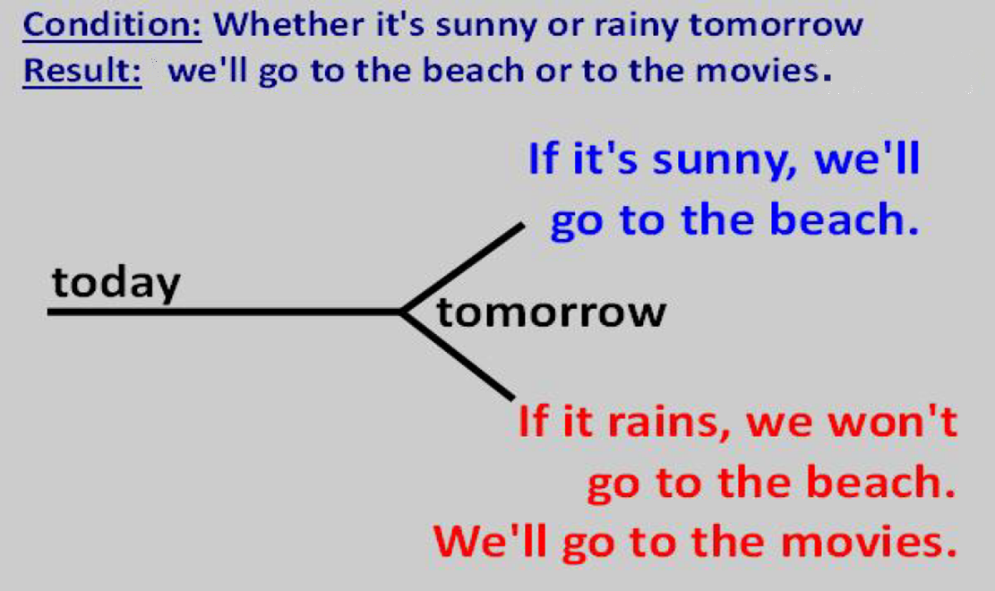
First Conditional: Real Future Possibilities
We can also reverse the order of the condition and result in the sentence, with no change in meaning:
We'll go to the beach if it's sunny tomorrow.
We'll go to the movies if it rains tomorrow.

Slide 8
Other words besides “If”
In first conditional sentences, it is possible to use other words instead of “if” or “unless”:
“As long as” or “providing that” mean “but only if”.
Compare:
They’ll succeed but only if they try hard.
They’ll succeed as long as they try hard.
As soon as (to emphasize immediacy):
Ex: This situation is very urgent. I’ll call you as soon as I have more information.
When, as soon as, by the time, the moment (that), until… They are called time clauses but they have the same structure as First Conditional Sentences.

Slide 9
Practice time!
Now choose the correct option for each verb:
I'm going to take a shower as soon as I get / will get home from the gym
Unless I find/ will find my watch, I have / I'll have to buy a new one.
If the surgery isn't / won’t be successful, he has / 'll have just six months to live.
You have / You’ll have a great time if you go / you’ll go to Rio.
We are / We’ll be disappointed if nobody comes / will come to our party on Friday.
If you forget / you’ll forget your wife's birthday next week, she is / she’ll be upset.
I give / I’ll give him the documents when I see / I’ll see him later today.
When I get / will get married, I have / I’m going to have a simple wedding.

Slide 10
SUMMARY: Real Conditionals
Conditionals are sentences in which one thing depends on another.
Use the zero conditional for things that happen regularly in daily life - "If you freeze water, it turns to ice." Both verbs are in the present simple .
The word if implies that a situation happens less frequently, and the word when implies it happens more frequently.
Use the first conditional for things that are real possibilities in the future: "If it's sunny tomorrow, then we'll go to the beach." Although both events are technically in the future, we use the present simple in the condition, and will/going to in the result.

Slide 11
SUMMARY
You can use when instead of if when the condition will definitely happen in the future.
Use as soon as to emphasize that the result will immediately follow the condition
Use unless in place of "if not.“
Use as long as or providing that to emphasize the condition. It means “but only if”.

Slide 12
Unreal Conditionals
They are used to talk about imaginary, unlikely, or impossible situations in the present and past:
Second Conditional:
If I owned a car, I would drive to work.
(imagining things are different in the present)
Third Conditional:
If I had studied harder, I would have passed last week’s test.
(imagining things were different in the past)
Mixed Conditional:
If I had finished my work yesterday, I wouldn't be so stressed out today.
(mix of times - imagining something different in the past having a different result in the present)

Slide 13
Imagining the Present were different
One simple way to imagine that things in the present were different is to use
wish + past simple (ojalá…)
Example:
I live near the beach, but I wish I lived near the mountains.
My boyfriend is so busy that he has no time for me. I wish he didn’t work so much.

Slide 14
Second conditional
Now we'll take those wishes one step further and imagine the result; imagine what would happen if they were currently true. This is the second conditional:
Example:
If I lived near the mountains, I would go hiking every weekend.
If my boyfriend didn’t work so much, we'd go out
more often.

Slide 15
Second Conditional
If I had a lot of money, I would buy a big house.
Condition Result
If I knew his number, I would (I’d) phone him.
if-clause:
PAST SIMPLE TENSE
main clause:
CONDITIONAL SIMPLE
would / might / could + infinitive
We use would when the result is more definite or certain.
Ex: If Peter asked Karen out, she would say yes.
We use might when the result may or may not happen:
Ex: If Peter asked Karen out, she might say yes... or she might say no.
We use could to talk about possibilities or abilities.
Ex: If I had a million dollars, I could buy a helicopter,
I could live in a mansion, I could quit my job….

Slide 16
One final note on Second Conditional
Which is correct?
If I was rich, I’d buy a boat. Or If I were rich, I’d buy a boat.
If Dana was here right now, she’d agree.
If Dana were here right now, she’d agree.
Technically the correct answer is were in both cases… even though the subject is singular, we use were when talking about hypothetical situations. However, informally, more and more people are saying sentences like these with was when the subject is singular. It’s not correct, but it is common. To be on the safe side, it’s best to stick with were!
One very common phrase for giving advice is in the second conditional: “If I were you, I’d…”

Slide 17
SECOND CONDITIONAL
Jack wants to buy a house but he can’t do this because he doesn’t have any money.
If I had a lot of money,
I would buy a big house.
I wish I …
I wish I had a lot of money to buy a house.

Slide 18
SECOND CONDITIONAL
Susan wants to phone Paul but she can’t do this because she doesn’t know his number.
If I knew his number,
I would phone him.
I wish…
I wish I knew his number…

Slide 19
Practise time! 2nd conditional
Complete the sentences with the verbs in the correct tenses. Pay careful attention to which part of the sentence is the condition, and which part is the result! When possible, abbreviate “would” to “‘d”.
If you _____(eat) a healthy breakfast, you __________ (have) more energy.
I ___________ (call) him if I ___________ (have) his number.
If he __________ (be) more organized, he __________________ (not forget) so many things.
How long _________________ (it take) if we __________ (hire) someone to do this work?
ate
‘d have
‘d call
had
were
wouldn’t forget
would it take
hired

Slide 20
FIRST v. SECOND CONDITIONAL
If John runs fast, he will win the race.
This is still possible to happen.
If John ran fast, he would win the race.
This is unlikely to happen because John doesn’t run fast.
THE DIFFERENCE: FIRST and SECOND CONDITIONAL
Both conditionals refer to the present and future.
The difference is about probability, not time.
First conditional: real and possible situations
Second conditional: unlikely to happen

Slide 21
Third Conditional – Imagining that the PAST had been different
Let's imagine a different past using wish. For hypothetical past situations, use
wish + past perfect (had + p. part)
Examples:
I was late for work today. I wish I had woken up 15 minutes earlier.
I wish I hadn’t eaten that seafood yesterday – it made me sick.
This is used to express regret (such as for eating that seafood) or past situations you wanted to be different (such as wishing you had woken up earlier).

Slide 22
THIRD CONDITIONAL
Now we'll take those wishes one step further – imagining the result, in the past, if that past situation had been different:
If I had woken up 15 minutes earlier, I would have arrived on time.
If I hadn’t eaten that seafood yesterday, I wouldn’t have got sick.
if-clause:
PAST PERFECT SIMPLE
had + past participle
main clause:
CONDITIONAL PERFECT
would / could / might + have + p. participle
Other examples:
If we had brought our camera, we might have taken a picture.
Sarah could have learnt French if she had taken lessons.
The third conditional refers to the past and it is not based on facts. It expresses an impossible situation.

Slide 23
THIRD CONDITIONAL
Jack wanted to buy a house last year but he couldn’t do that because he didn’t have any money.
If I had had a lot of money,
I would have bought
a big house.

Slide 24
THIRD CONDITIONAL
Yesterday, Susan wanted to phone Paul but she couldn’t do that because she didn’t know his number.
If I had known his number,
I would have phoned him.

Slide 25
SECOND v. THIRD CONDITIONAL
If I saw a car accident, I would call an ambulance.
But I don’t see an accident now. This is unlikely to happen.
If I had seen a car accident, I would have called an ambulance.
But I didn’t see an accident yesterday.
THE DIFFERENCE: SECOND and THIRD CONDITIONAL
The difference is about time.
Second conditional: refers to the present and future.
Third conditional: refers to the past situations.

Slide 26
A bit of rephrasing…
I’m not rich so I don’t travel a lot. => If I…
If I were rich, I’d travel a lot.
b) She didn’t wake up early, so she missed the train. =>
If she the train.
If she had woken up earlier, she wouldn’t have missed the train.
c) I didn’t call you because I came back really late. =>
I earlier.
I would have called you if I had come back earlier.
d) He doesn’t have a job, that’s why he can’t buy a house. =>
If he …
If he had a job, he would be able to buy a house.

Slide 27
e) He had that terrible accident because he wasn’t careful. =>
If he accident.
If he had been careful, he wouldn’t have had that terrible accident.
e) I didn’t work hard, so I didn’t pass the exam. =>
If I the exam.
If I had worked hard, I would have passed the exam.
f) They can’t live in this country because they can’t find a job here. =>They a job here.
They’d live in this country if they found a job here.
g) Visiting Israel won’t be possible without a visa. =>
Unless you Israel.
Unless you have a visa, you won’t be able to visit Israel / it will be impossible to visit Israel.

Slide 28
ALL CONDITIONALS
0. If it rains, the grass gets wet.
General time reference.
1. If it rains today, you will get wet (you don’t have an umbrella).
This is still possible to happen.
2. If it rained, you would get wet.
But the sky is blue. This is unlikely to happen.
3. If it had rained yesterday, you would have got wet.
But it didn’t rain, so you didn’t get wet.(past situation)

Slide 29
WISH – IF ONLY…
Remember: We use “wish” to describe situations that we wish were different, or that we are sorry about. It’s usually translate by “desearía, me gustaría” or “ojalá”. It’s followed by a that- clause (although “that” can be omitted).
“If only” has the same meaning as “I wish” but it’s more emphatic. Its equivalent in Spanish is “ojalá” (whatever the object is) or “si al menos”. The clause with “if only” often stands alone, without a main clause.

Slide 30
WISH – IF ONLY… (2)
Both “wish” and “if only” can be used with:
a) Past simple (to talk about the present events. It expresses regret that things are not different) :
I wish / If only I had a better job. I wish I was taller.
Remember! To be in the past: always “were”: I wish were that simple!
b) Past Perfect (to talk about the past and it expresses regret about them.)
Oh, I wasn’t expecting you. I wish you had called before coming over.
If only she hadn’t told the police, everything would have been all right.
c) Could / Would + infinitive (We’re not happy about a situation (regret, annoyance) and we wish it changes in the future).
I wish I could afford it. If only it would stop raining!
Everybody wishes you would go home. (Why don’t you go home?)
If the subject is “I” or ”we” => “could” is often used.
I wish our sales would improve <=> I wish we could go together.

Slide 31
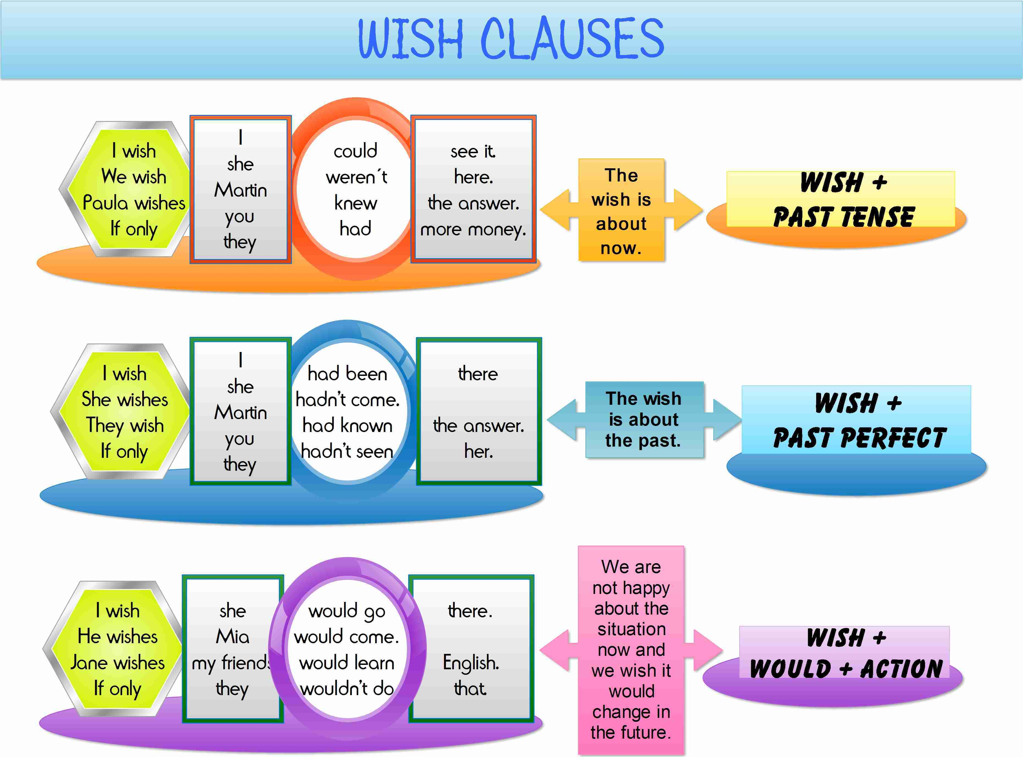

Slide 32
THE END!
Thanks to Shayna Oliveira (Advance Grammar Course www.espressoenglish.net). Her book has been a great help!

