Slide 1


ability
VI grade, by B.T.

Slide 2

AFFIRMATIVE
I can
We can
You can
You can
He can
They can
She can
It can

Slide 3

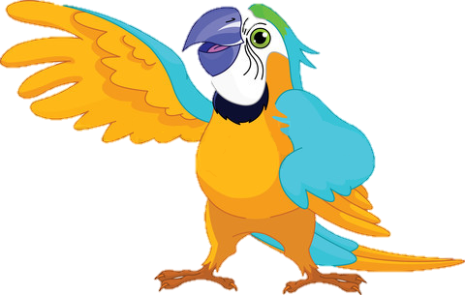
Parrots can talk
Yes, we can
ability

Slide 4
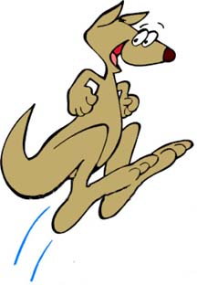
Kangaroos can jump
ability

Slide 5
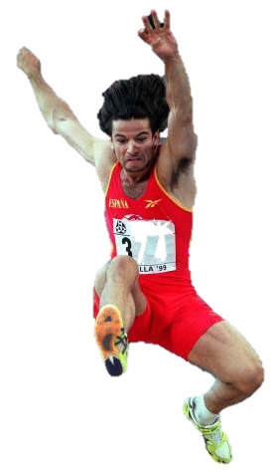
Humans can jump too
ability

Slide 6
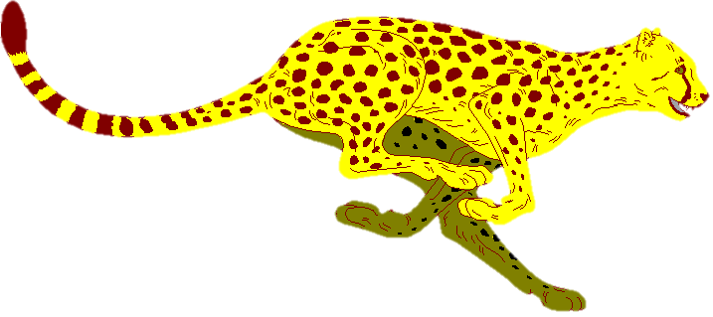
Cheetahs can run very fast
ability

Slide 7
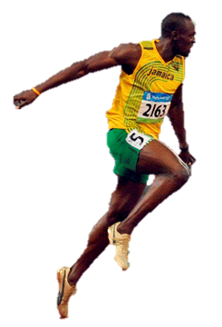
Some people can run very fast too
ability

Slide 8

Dolphins can swim
ability

Slide 9
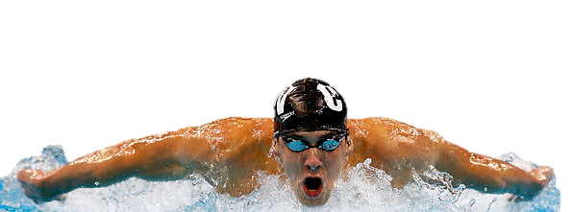
Many people can swim too
ability

Slide 10

NEGATIVE
I can’t
I can
not
You can’t
You cannot
He can’t
He cannot
She can’t
She cannot
It can’t
It cannot
We can’t
We cannot
You can’t
You cannot
They can’t
They cannot

Slide 11
Parrots can’t swim
No, we can´t
ability

Slide 12

Kangaroos can’t talk
ability

Slide 13
Dolphins can’t run
ability

Slide 14
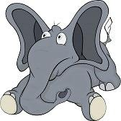
Elephants can’t jump
ability

Slide 15
INTERROGATIVE
QUESTIONS
SHORT ANSWERS
Can I?
I
can
?
Yes, I/you can
No, I/you can’t
Can you?
You
can
?
Can he?
He
can
?
Can she?
Yes, he/she/it can
No, he/she/it can’t
She
can
?
Can it?
It
can
?
Can we?
We
can
?
Can you?
Yes, we/you/they can
No, we/you/they can’t
You
can
?
Can they?
They
can
?

Slide 16
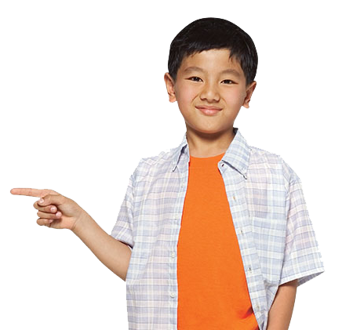
Can dolphins swim?
Yes, they can
ability

Slide 17

Can elephants jump?
No, they can’t
ability

Slide 18
Can kangaroos fly?
No, they can’t
ability

Slide 19
Can parrots talk?
Yes, they can
ability

Slide 20

permission

Slide 21
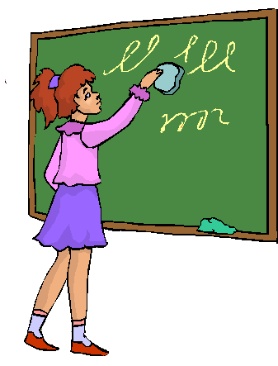
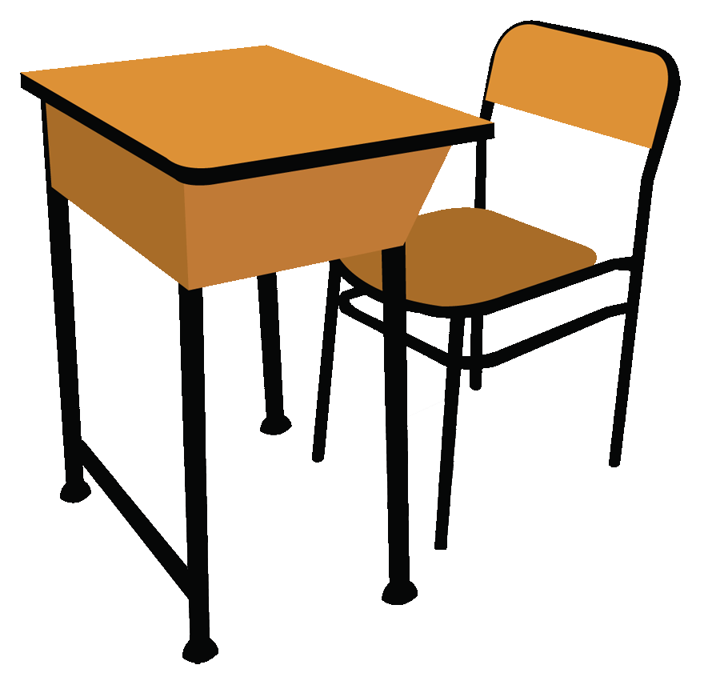
Can I clean the blackboard, please?
permission

Slide 22

Can I open the window, please?
permission

Slide 23
Can I sharpen my pencil, please?
permission

Slide 24
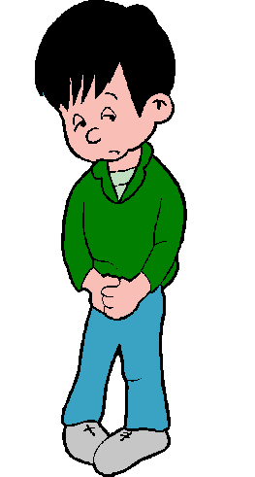
Can I go to the toilet, please?
permission

Slide 25
BYE BYE!

