Slide 1
DIRECT AND REPORTED SPEECH

Slide 2
CHANGE THE FOLLOWING SENTENCES TO REPORTED SPEECH.

Slide 3
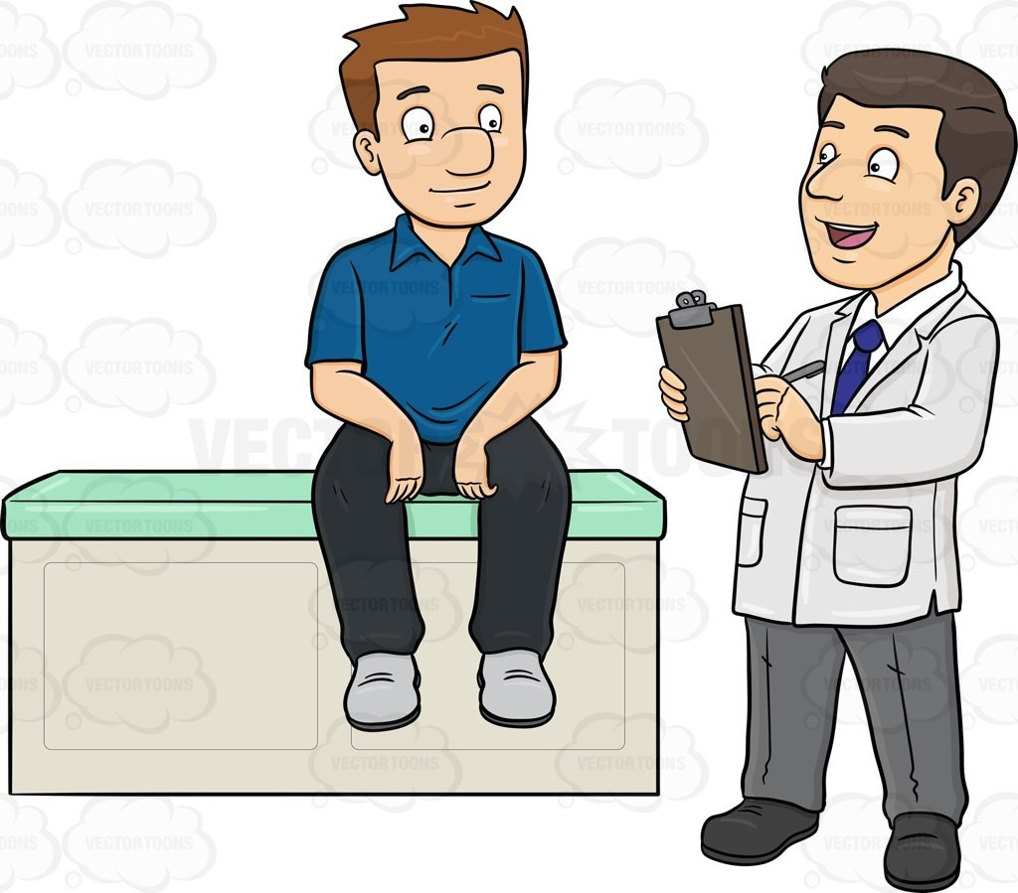
The doctor said to the patient,“Take the medicines regularly”.

Slide 4
The doctor advised the patient to take the medicines regularly.

Slide 5
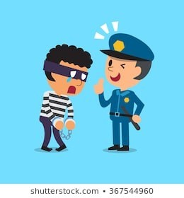
The policeman said to the thief, “Don’t cheat me”.

Slide 6
The policeman warned the thief not to
cheat him.

Slide 7
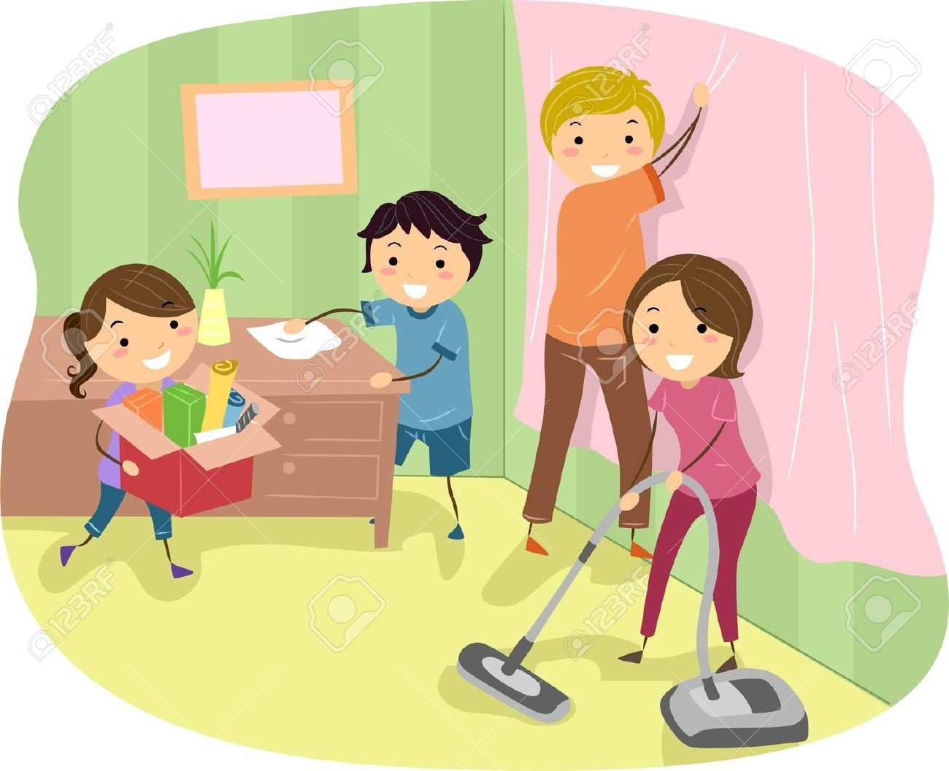
David said to the kids,“Please clean this room”.

Slide 8
David requested the kids to clean that
room.

Slide 9
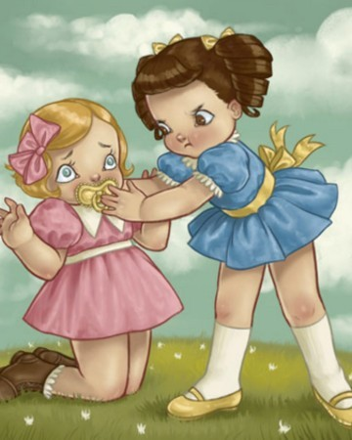
Monisha said to Sowmya,“Don’t shout”.

Slide 10
Monisha
ordered Sowmya not to shout.

Slide 11
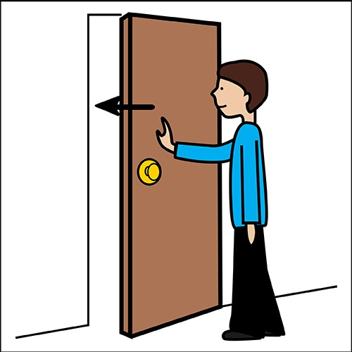
Mom said to Ram,“Please close the door”.

Slide 12
Mom requested Ram to close the door.

Slide 13
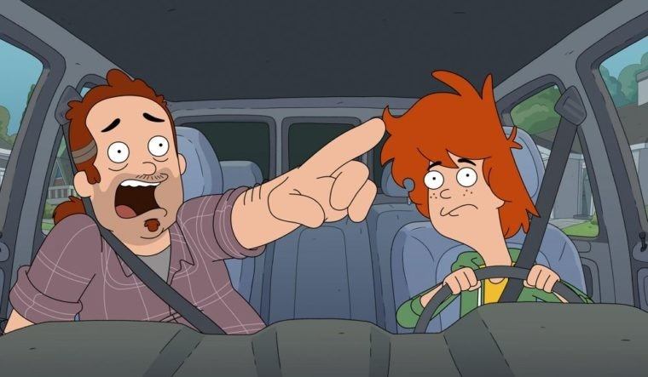
Peter said to Robin,“Drive carefully”.

Slide 14
Peter warned Robin to drive carefully.

Slide 15
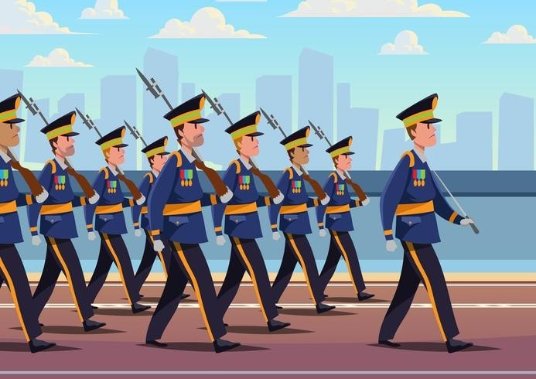
The captain said to the soldiers,“March past”.

Slide 16
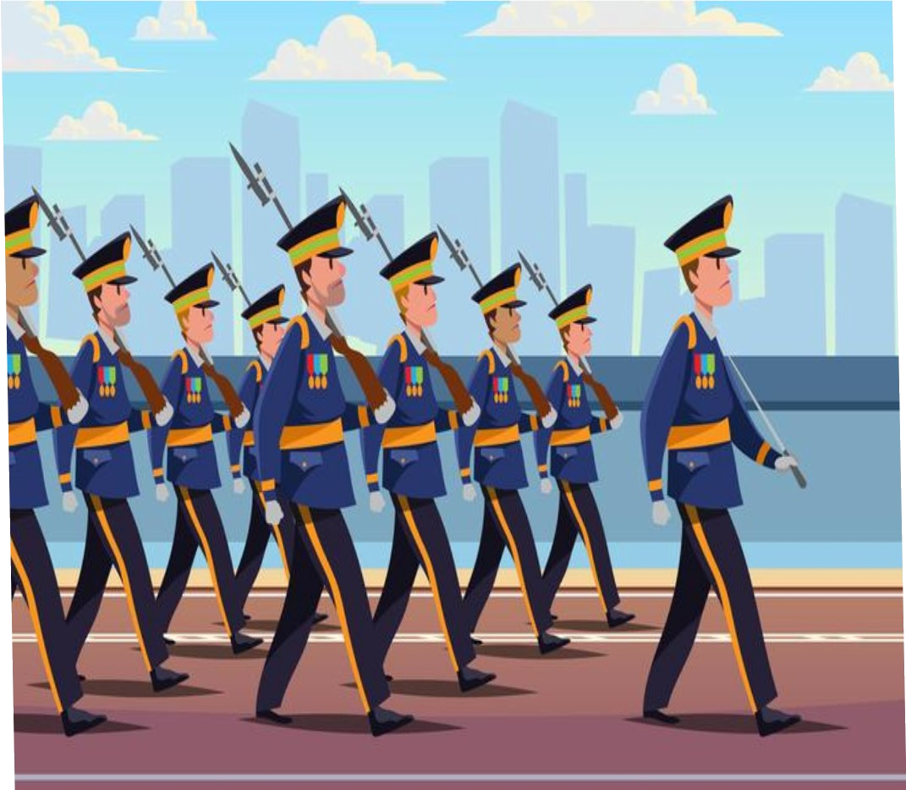
The captain ordered the soldiers to march past.

Slide 17
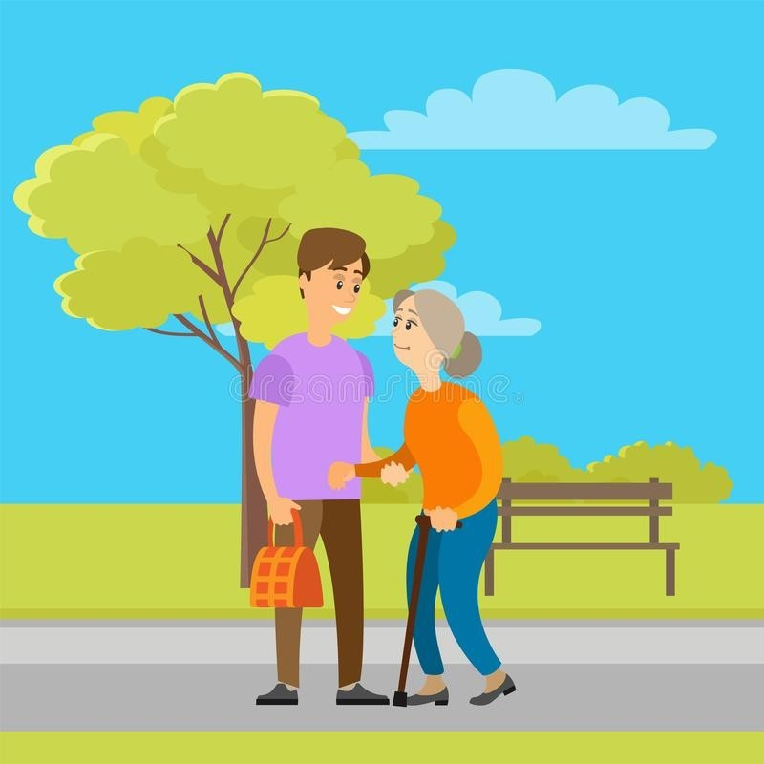
The old lady said to the young boy,“Please help me to cross the road”.

Slide 18
The old lady requested the young boy to help her to cross the road.

Slide 19
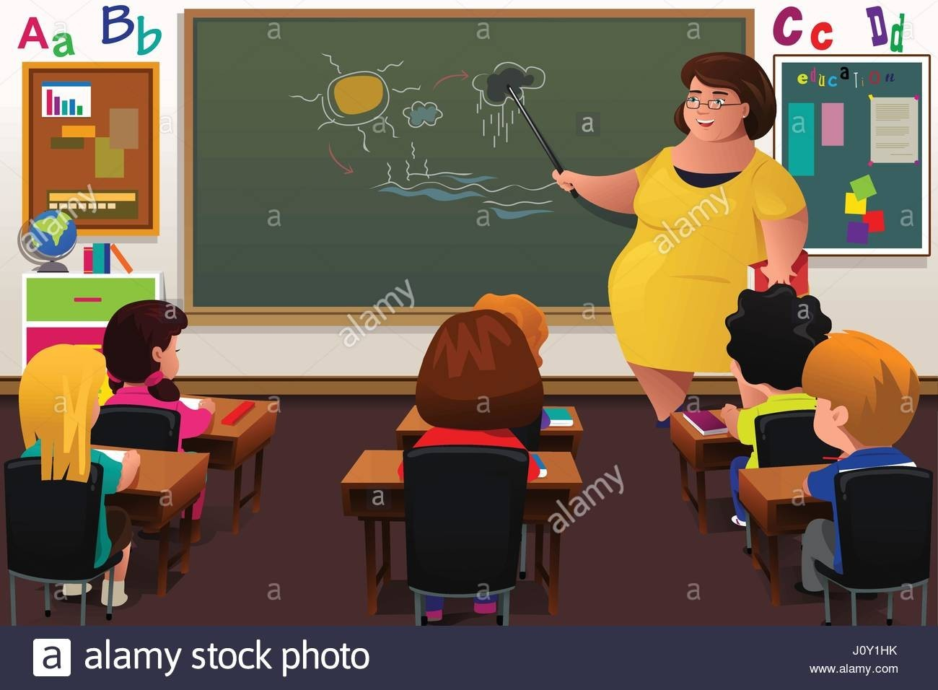
The teacher said to the students,“Listen carefully”.

Slide 20
The teacher ordered the students to listen carefully.

Slide 21

Priya said to Varshan,“Please switch on the fan”.

Slide 22
Priya requested Varshan to switch
on the fan.

Slide 23
THE END

