Slide 1
Past perfect and past perfect continuous

Slide 2
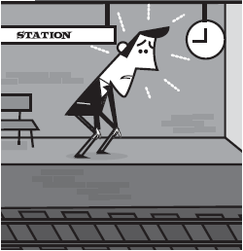
Past perfect simple
When he arrived, the train had gone.
had (or ‘d) + the past participle
had gone
he arrived
past
now

Slide 3
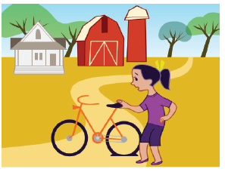
Past perfect continuous
She’d been riding her bike for two hours, so she got off
for a rest.
had (or ‘d) been + verb-ing
riding her bike
now
2 hours
she got off

Slide 4
Past perfect simple vs. continuous
I had been reading a horror story and I was feeling scared.
I had read all my magazines and I was getting bored.
Dad had been cooking all afternoon and it smelled great.
Dad had cooked the dinner and so he asked me to wash up.
As soon as I’d taken the medicine I felt better.
I’d been taking the medicine for two days before I started to feel better.
Explain the difference in meaning between the pairs of sentences.

Slide 5
GET IT RIGHT!
1 We were training for weeks, but we lost the match.
2 I realised that we met before.
BUT
3 When I saw him, he had been waiting for a bus.
We had been training for weeks, but we lost the match.
I realised that we had met before.
When I saw him, he was waiting for a bus.

Slide 6
Language in action
The doctor’s surgery was full last Tuesday. Dr Barns arrived early to prepare for the day but Dr Harris had been there since 6 am to deal with emergency appointments. The receptionist arrived shortly after Dr Barns and then the patients started to arrive. When Mrs Jolly arrived, Mrs James had already been waiting for 10 minutes. Mrs James had had a heart attack the year before, so she was there for a check-up. Mrs Jolly had been feeling sick and didn’t feel like waiting. A little boy had badly cut his knee at school so he had to be seen as soon as he arrived and the ladies had to wait.
1 Write the order of how people arrived at the doctor’s surgery on a timeline.
2 Add when the injuries or illnesses occurred to the timeline.

Slide 7
Can you remember the rules?
Past perfect simple
We use the past perfect when we need to make it clear that one action happened before another action in the past.
When we got to the theatre, the play had started.
(= The play started before we got to the theatre.)
Compare this with:
When we got to the theatre, the play started.
(= The play started when/after we got to the theatre.)

Slide 8
Past perfect continuous
We use the past perfect continuous to talk about situations or activities that started in the past and were still continuing at another time in the past.
She was very tired because she had been working for a very long time.
When we got there, they hadn’t been waiting long.

Slide 9
Work in groups. Match the red problems with the blue reasons. Then use the phrases to tell a story.
Speaking
burnt the cake
not many guests
forgot to go to the shop
nothing to drink
DJ got lost
no birthday cake
… the party was a total disaster and I went to bed tired and upset.
forgot to send out invitations
no time to go clothes shopping
no new clothes to wear
no music

Slide 10
Speaking
Student A: Make a list of 8 things you did on Saturday or Sunday. Write them on different pieces of paper.
I did my homework.
I went to football training.
I met my friends in the park for a picnic.
I went to the cinema.
Student B: Work with a partner. Swap your pieces of paper. Take it in turns to ask questions to put your friend’s day in order.
Had you already been to football training before you met your friends?
No I hadn’t.

Slide 11
Acknowledgements
The publishers are grateful to the following illustrators:
Slide 2: David Semple
Slide 3: Bryan Beach (Advocate Art)

