Slide 1
Present Simple versus Present Continuous

Slide 2
What is the difference between these two sentences?
Present Continuous
My brother is playing football with his friends.
He plays football every Sunday.
Present Simple

Slide 3
When do we use the Present Continuous Tense?
For actions happening at the moment of speaking.
Examples:
You are learning English now.
Are you sleeping?
I am sitting.
Is he sitting or standing?
They are reading their books.
They are not watching television.
What are you doing?
Why aren't you doing your homework?

Slide 4
When do we use the Present Continuous Tense?
2. For longer actions in progress.
Examples:
I am studying to become a doctor.
I am reading the book Tom Sawyer.
I am not reading any books right now.
Are you working on any special projects at work?
Aren't you teaching at the university now?

Slide 5
When do we use the Present Continuous Tense?
3. To indicate that something will or will not happen in the near future.
Examples:
I am meeting some friends after work.
I am not going to the party tonight.
Is he visiting his parents next weekend?
Isn't he coming with us tonight?
P.S.: In this case, you must give the time of the action.

Slide 6
When do we use the Present Simple Tense?
USE 1 - Repeated Actions
To express the idea that an action is repeated or usual. The action can be a habit, a hobby, a daily event, a scheduled event or something that often happens.
Examples:
She does not play tennis.
Does he play tennis?
The train leaves every morning at 8 AM.
When does the train usually leave?
He never forgets his wallet.
Every twelve months, the Earth circles the Sun.
Remember the ‘s’ in the third person of the singular: He, She and It!!!

Slide 7
When do we use the Present Simple Tense?
USE 2 - Facts or Generalizations
To indicate real or made-up facts. It is also used to make generalizations about people or things.
Examples:
Cats like milk.
Birds do not like milk.
Do pigs like milk?
California is in America.
California is not in the United Kingdom.
Windows are made of glass.
Windows are not made of wood.
New York is a small city.
Everyone likes candy!

Slide 8
When do we use the Present Simple Tense?
USE 3 - Scheduled Events in the Near Future
This is most commonly done when talking about public transportation, but it can be used with other scheduled events as well.
Examples:
The train leaves tonight at 6 PM.
The bus does not arrive at 11 AM, it arrives at 11 PM.
When do we board the plane?
The party starts at 8 o'clock.
What time does class begin tomorrow?

Slide 9
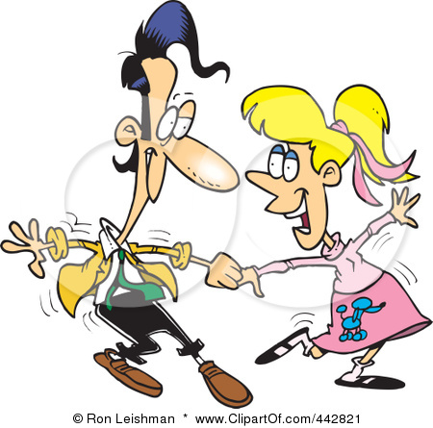
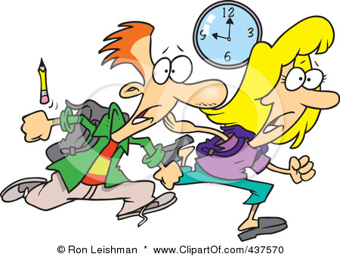
What do they normally do? What are they doing now?

Slide 10
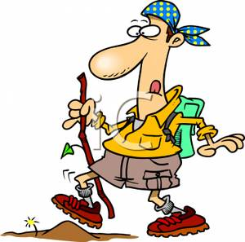
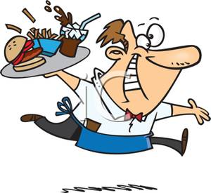
What does Jack do every day? He works at a restaurant every day.
What is Frank doing today?
He is going hiking today.
JACK
every day
today
work / go hiking

Slide 11
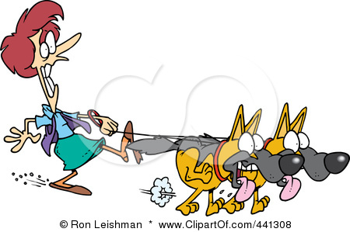
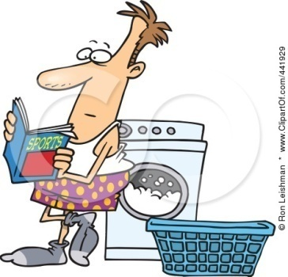
ASK AND ANSWER
JILL
on Fridays
at the moment
TOM
usually
now
take the dogs for a walk/ do gardening / take photos/ wash the clothes

Slide 12
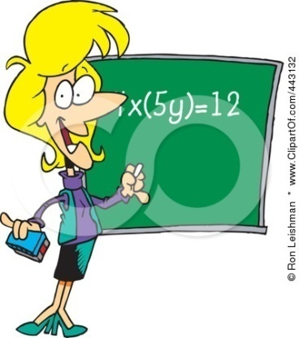
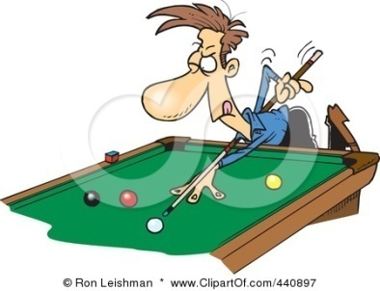
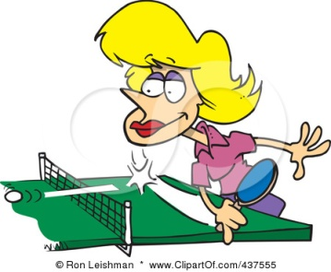
ASK AND ANSWER
David
in the evenings
this evening
Sandy
on weekdays
at the moment
teach / interview / play billiards / play table tennis

Slide 13
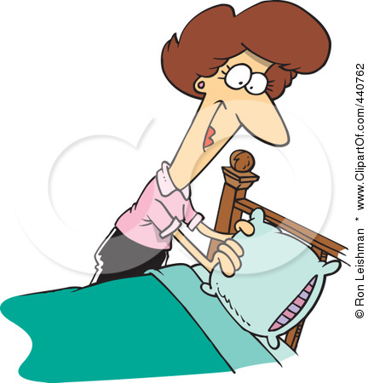
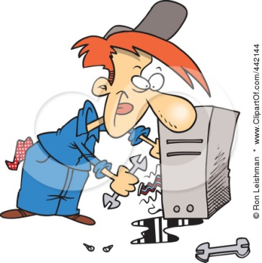
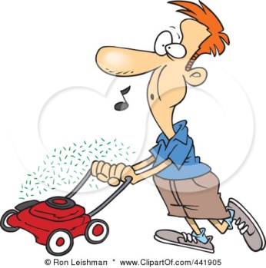
ASK AND ANSWER
Jason
from Monday to Friday
in this picture
Susan
always
now
write letters / repair computers / make the bed / cut the grass

Slide 14
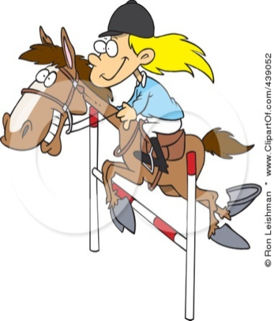
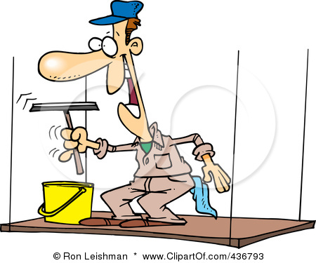
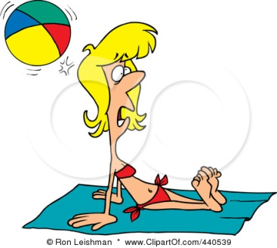
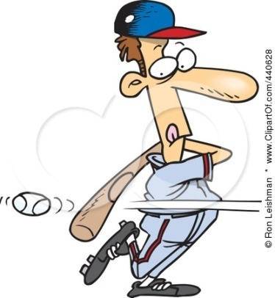
ASK AND ANSWER
Kelly
sometimes
in July
Gary
at the weekend
today
sunbathe / clean the windows / ride a horse / play baseball

Slide 15
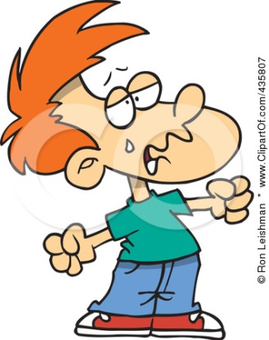
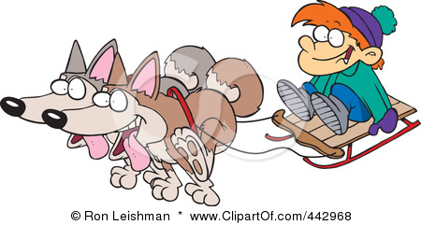
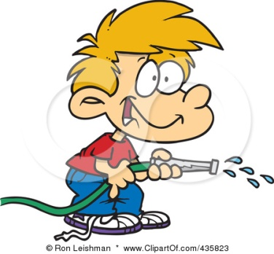
ASK AND ANSWER
Paul
never
in December
Mickey
at the moment
often
read a book / cry / water the flowers / go sledging

Slide 16
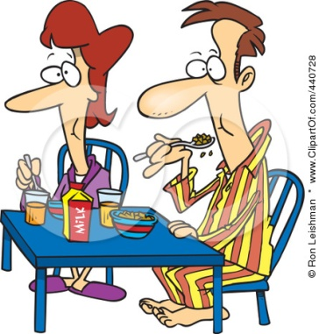
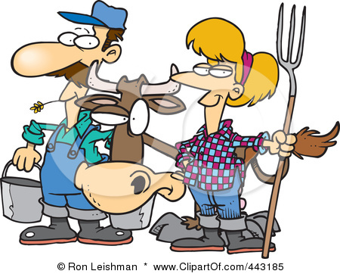
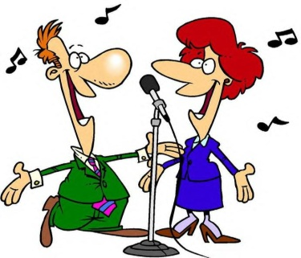
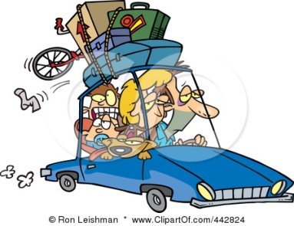
ASK AND ANSWER
Ellie & Joe
in the morning
this evening
Mary & Bob
regularly
on Saturday
feed the animals / go into town / have breakfast/ sing

Slide 17
ASK YOUR PAIR
YOU
in the evenings
today
YOU
every day
now
? / ? / ? / ?

Slide 18
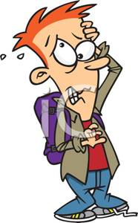
DO YOU REMEMBER? WHO ARE THEY?
She teaches on weekdays. She is playing table tennis at the moment.
He cleans the windows at the weekend. He is playing baseball today.
They regulalry feed the animals. They are going into town on Saturday.
He never cries. He is going sledging in December.

