Slide 1
Present Simple
6th GRADE
Made by: Julijana ZLATEVSKA

Slide 2
Use of Present Simple
To talk about permanent states/ facts/ general truths
To talk about habits
For timetables (school, train, bus, planes etc.)
e.g. I live in London
e.g. I play football every Tuesday.
e.g. My flight leaves at 9 o’clock.

Slide 3
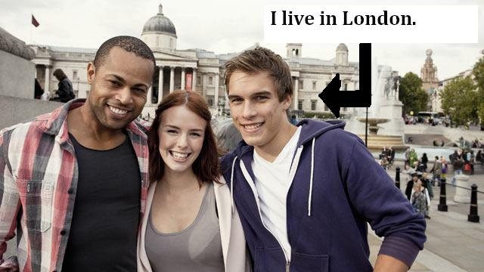
Use of Present Simple

Slide 4
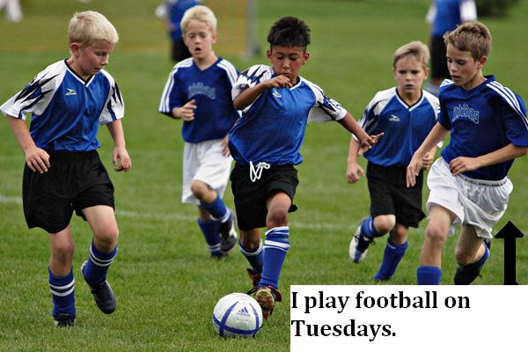
Use of Present Simple

Slide 5
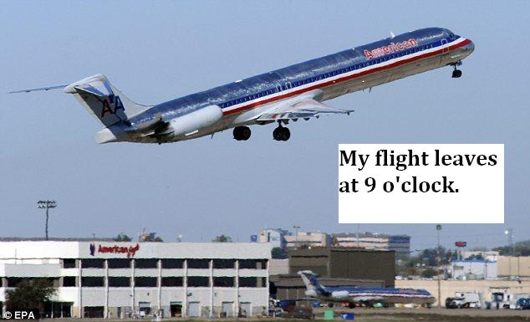
Use of Present Simple

Slide 6
Use of Present Simple
Permanent states
Habits
Timetables
Keywords:
Every Monday/week/month etc.
On Tuesdays/ Sundays etc.
In the morning/afternoon/ summer etc.
At Christmas/ Easter etc.

Slide 7
Adverbs of Frequency

Slide 8
Adverbs of Frequency
Adverbs of Frequency are also keywords for Present Simple.
They are placed before the main verb. ( EXCEPTION: verb “be”)
I always have breakfast.
I usually do my homework in the afternoon.
I often eat fish.
BUT: I am never late for school.

Slide 9
Present Simple Affirmative – Question - Negative
I work Do I work? I don’t work
You work Do you work? You don’ work
He works Does he work? He doesn’t work
She works Does she work? She doesn’t work
It works Does it work? It doesn’t work
We work Do we work? We don’t work
You work Do you work? You don’t work
They work Do they work? They don’t work
do+not: don’t does+not: doesn’t

Slide 10
Verb Conjugation 3rd singular
MOST VERBS --> We add –s : works, speaks, writes, loves
e.g. She always talks about school.
VERBS ENDING IN –S, -CH, -SH, -X, -O --> We add -es: kisses, reaches, washes, fixes, goes.
e.g. Ben never washes his hands!
VERBS ENDING IN CONSONANT+Y -->We remove “y” and add –ies : studies, worries, cries, studies
e.g. Mary sometimes studies at night.

Slide 11
Short Answers
We form short answers with:
Yes/No + Subject Pronoun +do/don’t/does/doesn’t
Do you like ice – cream? Yes, I do.
Does he play football every day? No, he doesn’t.
Do they wash the car on Mondays? Yes, they do.
Does Penny work? No, she doesn’t.
Do Paul and Jim go to school? Yes, they do.
Does Liam watch TV at night? No, he doesn’t.

