Slide 1
Англиски јазик – Прво одделение Наставник – Јанкуловска Александра ОУ елпида караманди - битола
Презентација на приказна:”The cat and the bell” - нов вокабулар

Slide 2
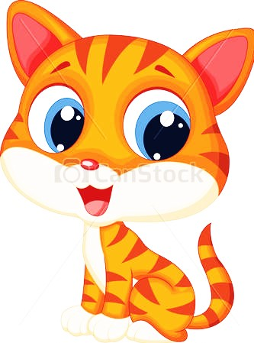
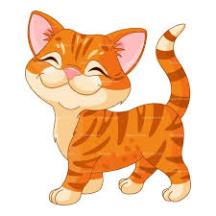
story - ”The cat and the bell” Once upoN A TIME THERE WAS A CAT. A very, Very quiet cat. so, so quiet.

Slide 3
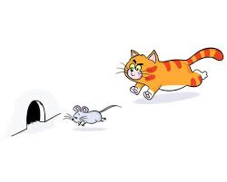
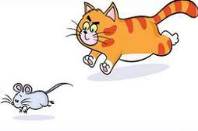
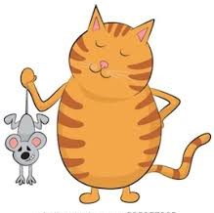
he would sneak ever so quietly around the house. so, so quietly. then suddenly….miaow. he pounced on a poor mouse.

Slide 4
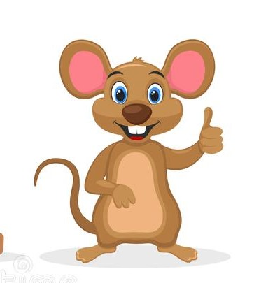
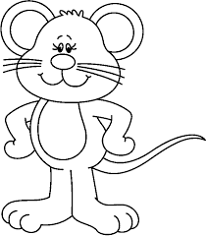
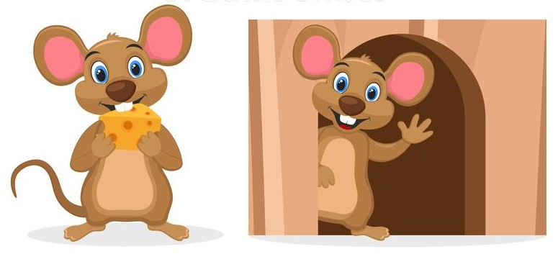
all the mice in the house were so, so scared of the quiet cat…. one day they had a meeting. “what can we do?” said brown mouse. “we can put a bell on the cat” said white mouse. “a bell – yes! a bell, yes, yes, yes, …!” said the brown and white mice.

Slide 5
“but how can we put a bell on the cat?” asked brown mouse. “On a collar” said white mouse. “a collar - yes, yes, yes!” said the brown and white mice. but how can we put a collar on the cat?” asked brown mouse. “A birthday present” said white mouse. “A birthday present - yes, yes, yes!” said the brown and white mice.

Slide 6
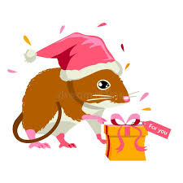
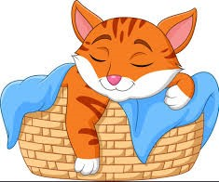
the brown and the white mice were very, happy – they took a very large bell and put it on a red collar. they wrapped it in a yellow and red paper. they tied a note on the parcel. it said happy birthday. quietly, so quietly the brown and white mice put the present in the cat’s basket.

Slide 7
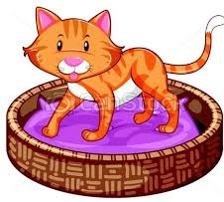
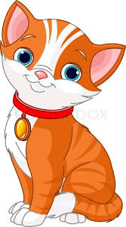
now when the cat woke up he was surprised! “a present” said he “let me see what’s inside!” he unwrapped the present and saw a big bell with a shining red ribbon. he tied it round his neck and walked round the house

Slide 8
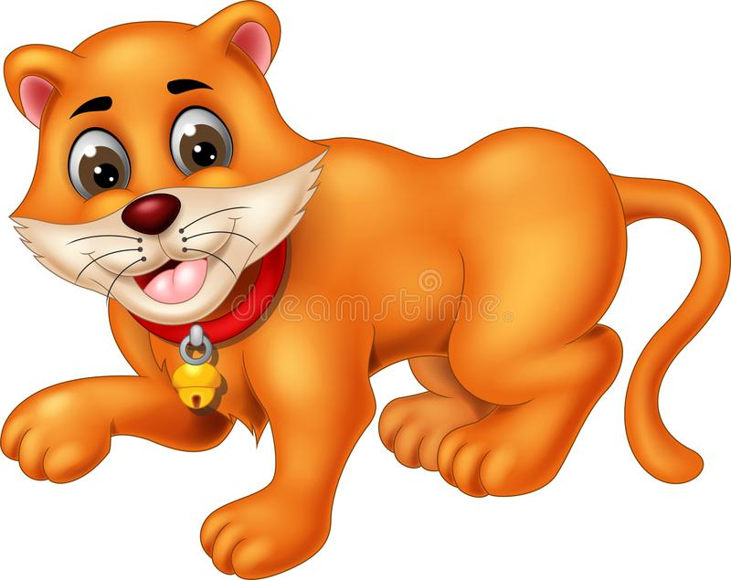
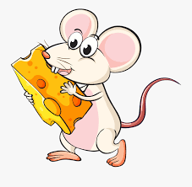
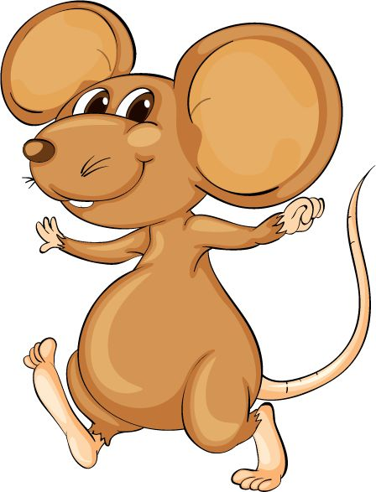
ding a ling ling went the bell. “I like my present” - purred the cat. and the brown and white mice said: “we like your present too”

Slide 9
Откако ќе се изврши презентација на приказната, истата се раскажува уште еднаш овој пат на македонски но со клучните зборови на англиски, се охрабруваат учениците да се вклучат во раскажувањето.
Клучни зборови – cat, mouse – mice (множинска форма од именката) се нагласува дека кога се работи за едно глувче велиме mouse, а за повеќе mice, bell, present, white, brown.

Slide 10
завршна активност
Нацртајте дел од приказната кој ви остави најголем впечаток

