Slide 1
Everyday activities
СЕКОЈДНЕВНИ АКТИВНОСТИ

Slide 2
get up

Slide 3
have breakfast

Slide 4
go to school

Slide 5
start school

Slide 6
have lunch

Slide 7
finish school

Slide 8
do homework

Slide 9
play sport

Slide 10
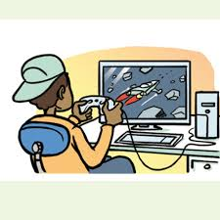
play computer games

Slide 11
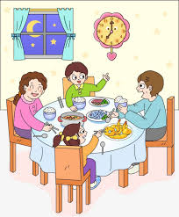
have dinner

Slide 12
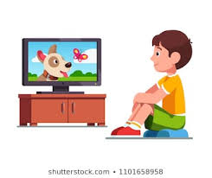
watch TV

Slide 13
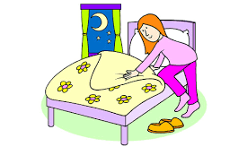
go to bed

Slide 14
Put the verbs in the gaps
get up – finish school- have dinner – watch TV- go to bed
1. I _______________ at 12: 30.
2. I _______________ at 19:00.
3. I _______________ at 20:00.
4. I _______________ at 7:00.
5. I _______________ at 21:00.

