Slide 1
Модални глаголи I година
Марија Гаштаров

Slide 2
ABILITY = Saber / poder
CAN = present
COULD = past
BE ABLE TO = all other tenses
EXAMPLES:
I can’t drive a car but I can ride a motorbike.
When I was 6, I could swim very well.
In two years I will be able to drive a car.

Slide 4
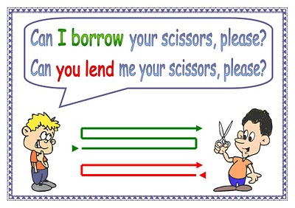
PERMISSION
CAN = informal
COULD = polite
MAY = formal
¿Puedo /podría…?
REQUESTS
CAN YOU…? = informal
COULD YOU…? = polite
WILL YOU…? = neutral
¿Puedes /podrías…?

Slide 5
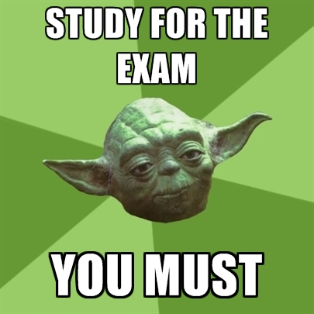
OBLIGATION = Deber / tener que
MUST = Present
HAVE TO = Other tenses (past, future…)
EXAMPLES:
We must treat each other with respect.
I have to be back home at 11.
When I finish school I will have to get a job.

Slide 6
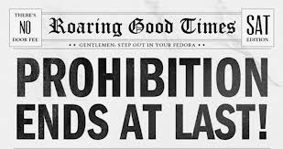
PROHIBITION
MUSTN’T = No debes
CAN’T = No puedes
EXAMPLES:
You mustn’t smoke so much, it’s too bad!
You can’t take photographs in this museum.

Slide 8
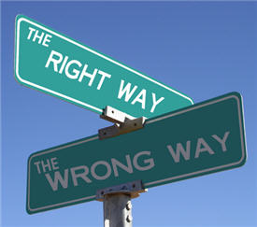
ADVICE = Consejo
SHOULD
HAD BETTER (= ‘D BETTER)
The government should protect people in need.
It’s cold in here. You should turn on the heating.
You shouldn’t tell anybody about this. It’s a secret.
You’d better go now. It’s getting late!

Slide 9
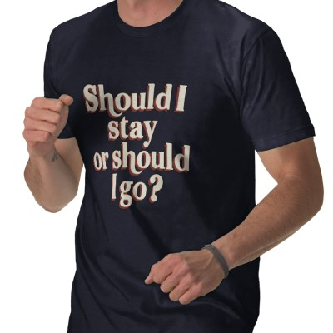

Slide 10
MODAL VERBS
http://www.learnenglish-online.com/grammar/modals/tests/modalability2.html
http://www.englishclub.com/grammar/verbs-modals-have-to-must-not-quiz.htm
http://www.english-grammar-lessons.com/musthaveto/exercise9.swf
http://www.englishgrammarsecrets.com/musthaveto/exercise7.swf

